Slide 1


K Street NW Traffic Analysis

Slide 2




Outline
Data Collection
Building a Calibrated Model
Analysis of Existing Network
Define the Two Initial Build Alternatives
Introduction
Project Schedule
Process Overview
Alternatives Analysis
Hybrid Alternative
Next Steps

Slide 3



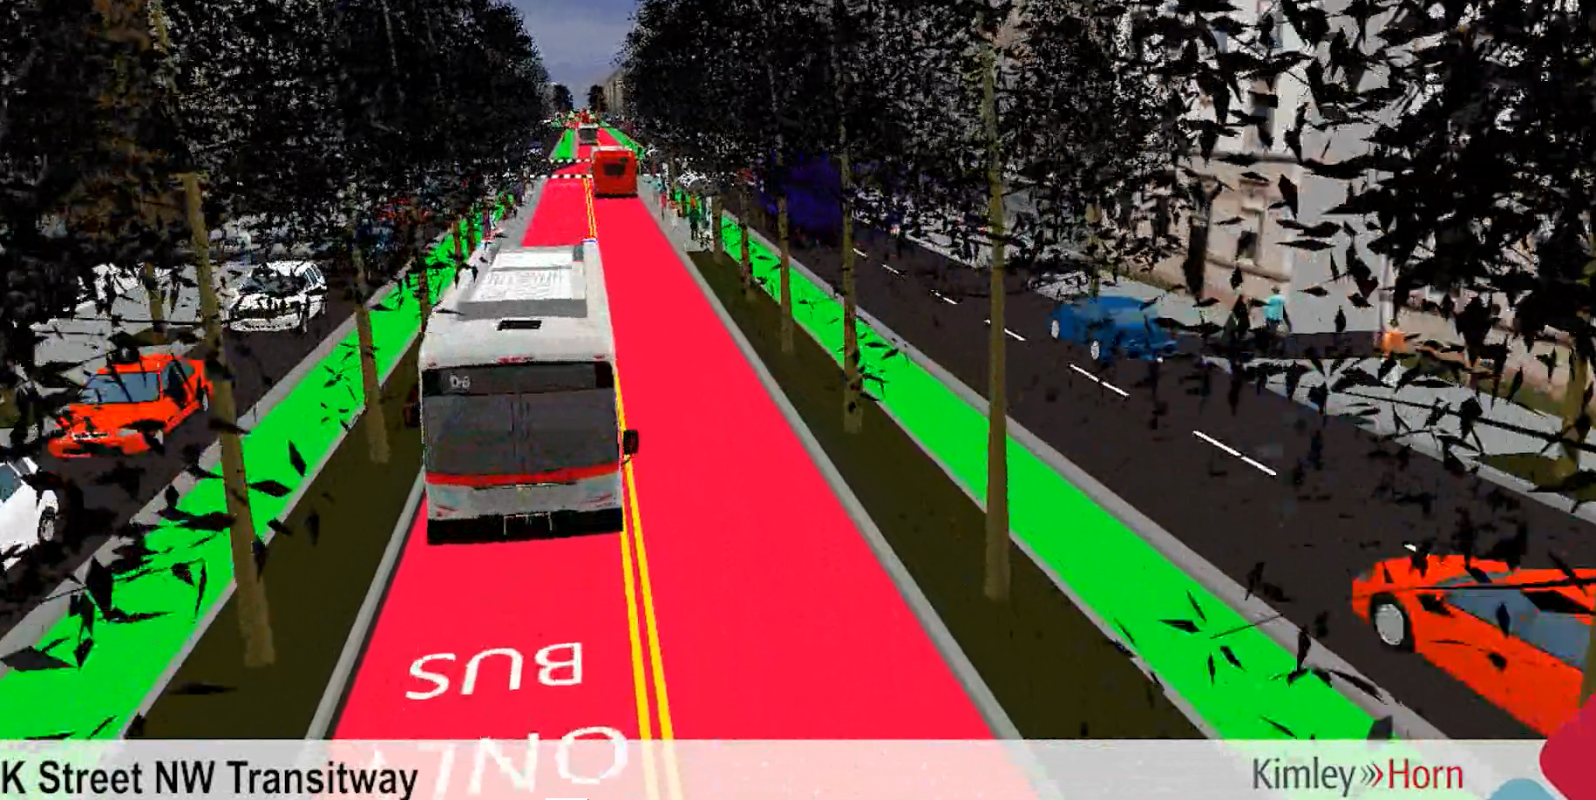

Introduction
The K Street Transitway is a priority project that will reconfigure one of the District's major east-west corridors, K Street NW, with vast improvements to benefit bus riders, motorists, cyclists, and pedestrians.
DDOT’s Project Goals:
Provide safe and reliable access for the largest number of people through the downtown corridor through prioritizing transit, pedestrian, and bicycle modes.
By focusing on dedicated and protected space for transit riders and cyclists, make it easier, faster, and more reliable for more people to get safely to and through downtown DC.
Bring mobility benefits to the greatest number of people by giving dedicated space to buses and enhancing pedestrian and bicycle infrastructure.
People in buses, on foot, and on bikes make up the majority of current – and future – K Street travelers.

Slide 4
Milestone Schedule
30% Design
Fall 2019 – Spring 2020
Final Design
Fall 2020 – Fall 2021
Construction
Start Early 2022
Traffic Analysis
Fall 2019 – Summer 2020

Slide 5
Traffic Analysis Process
Data Collection
Building a Calibrated Model
Analysis of Existing Network
Define the Two Initial Build Alternatives
Alternatives Analysis
Hybrid Alternative
Next Steps

Slide 6
Data Collection

Slide 7
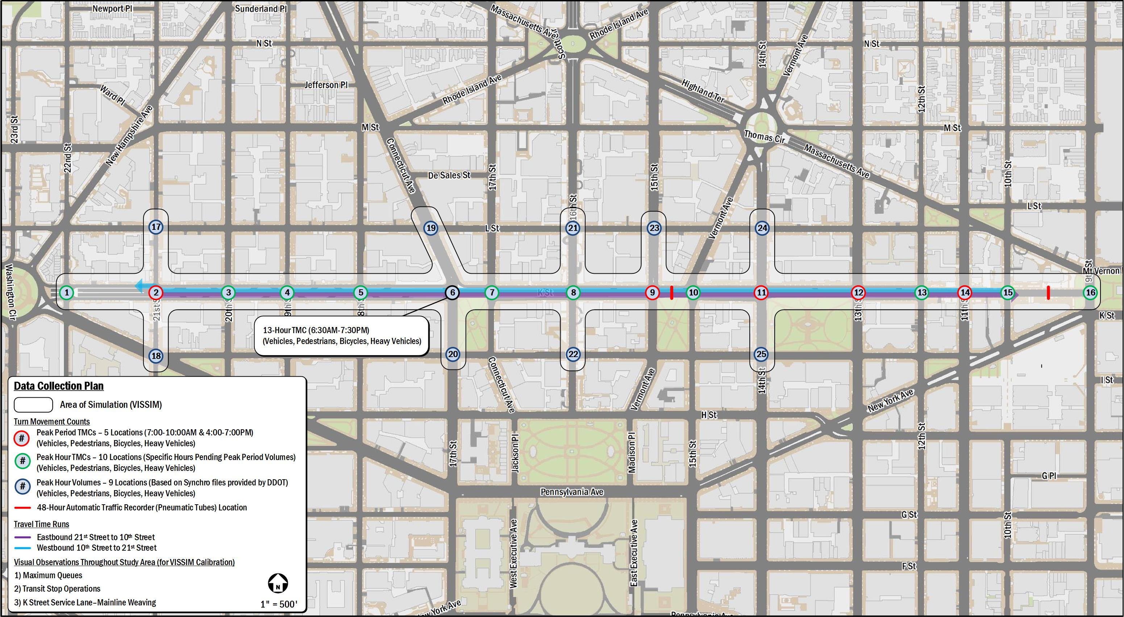
Data Collection Plan

Slide 8
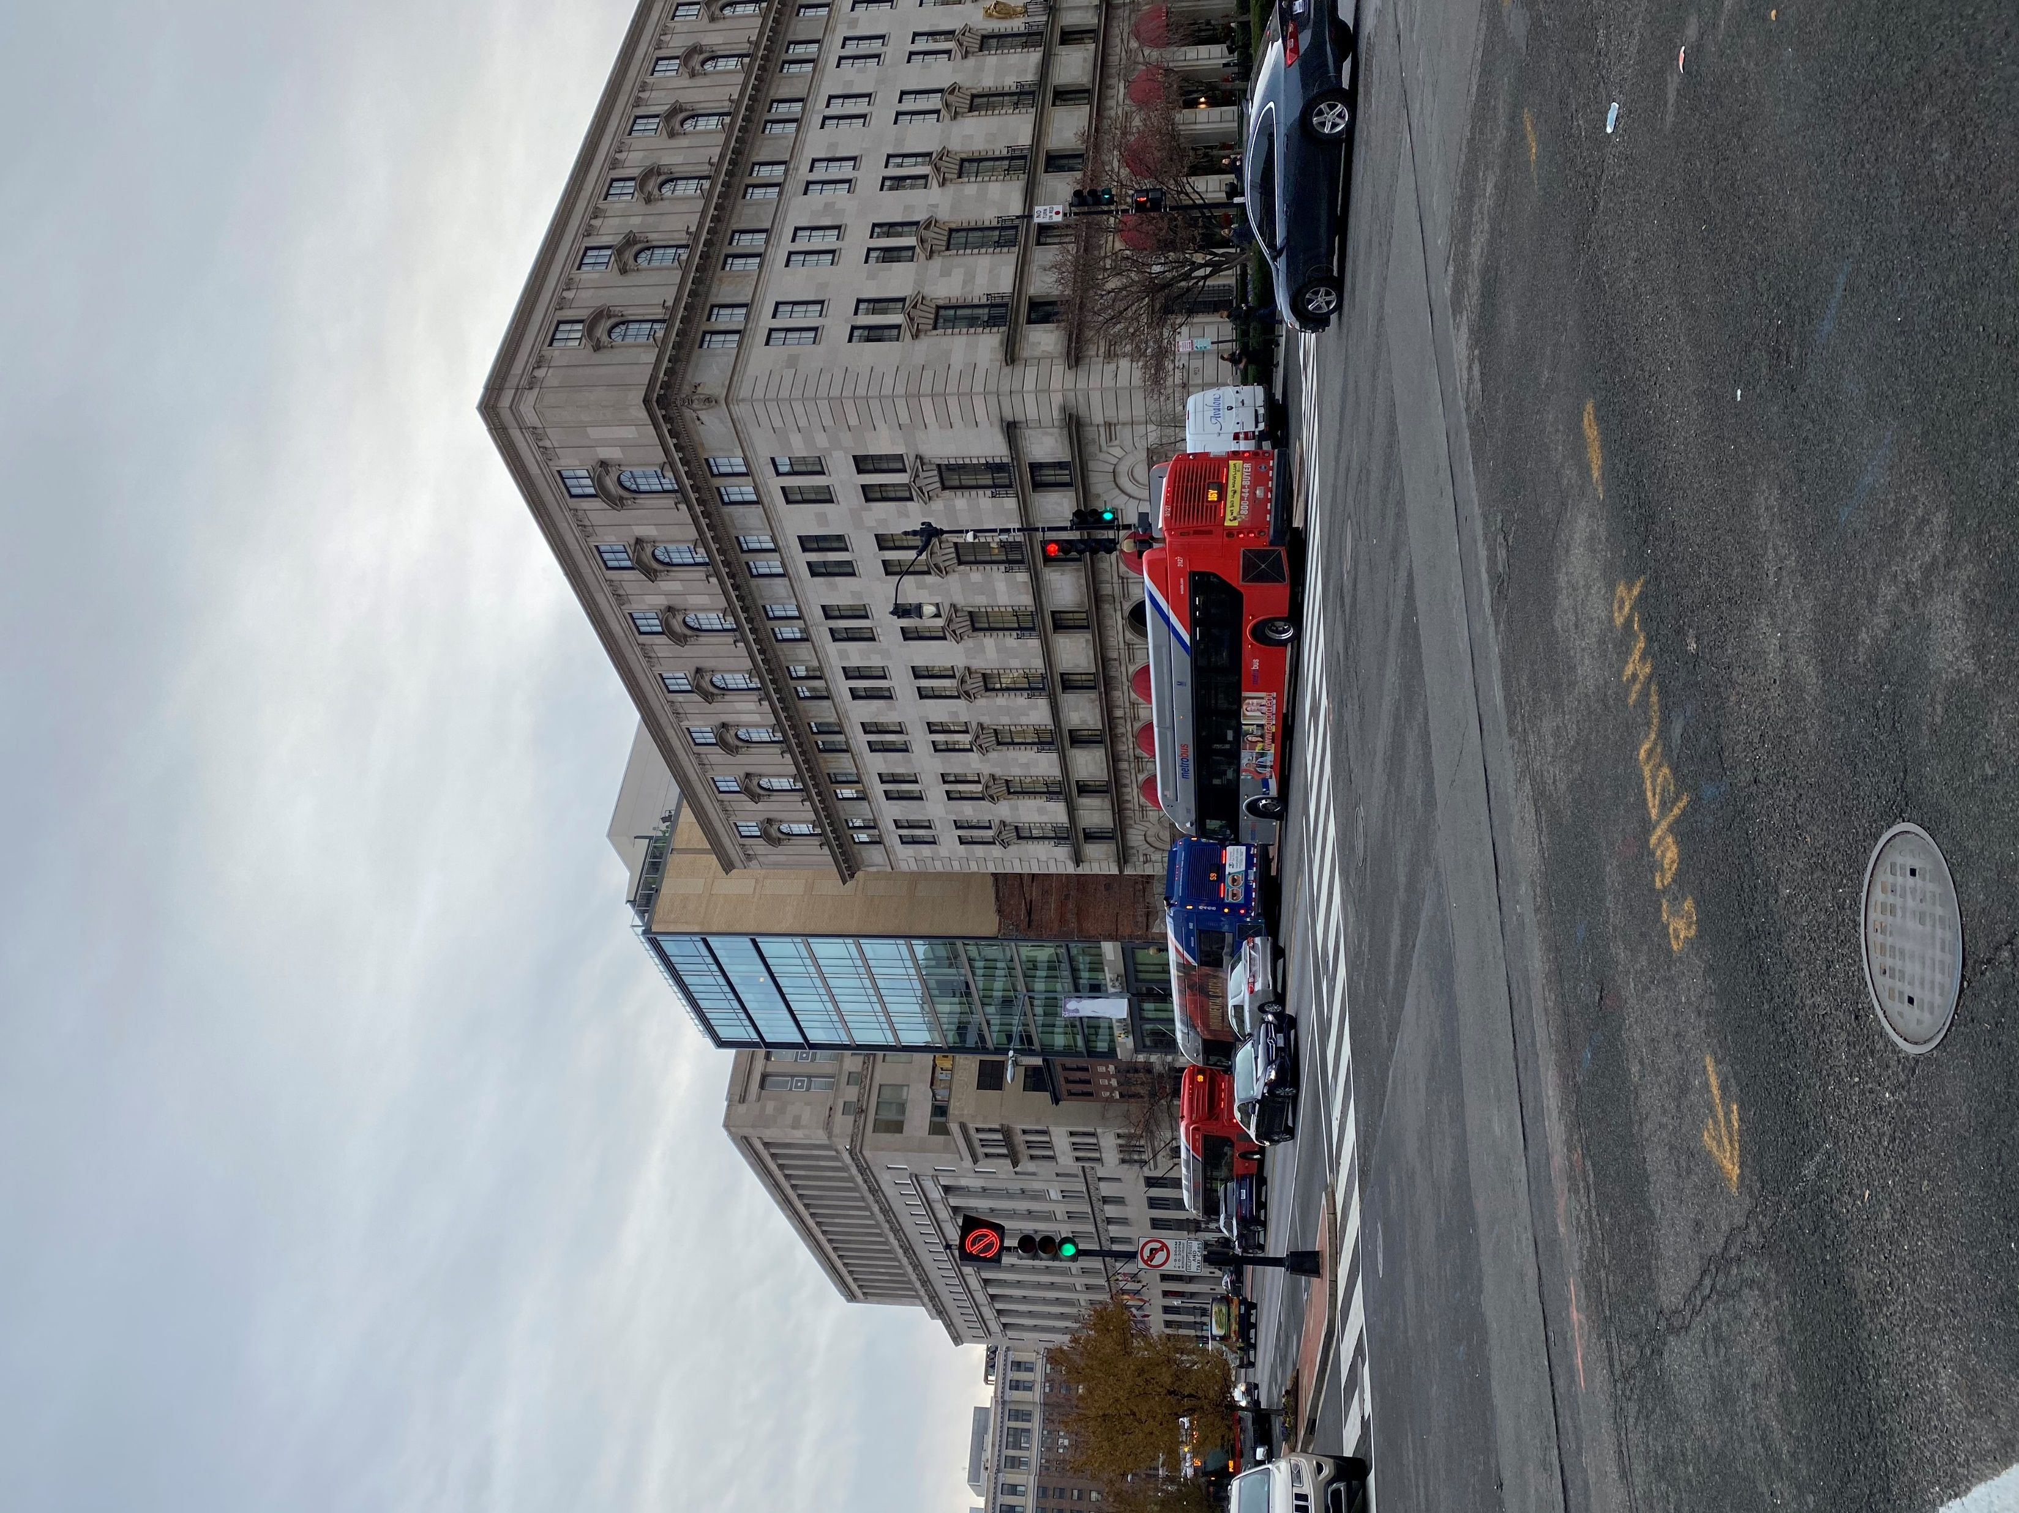
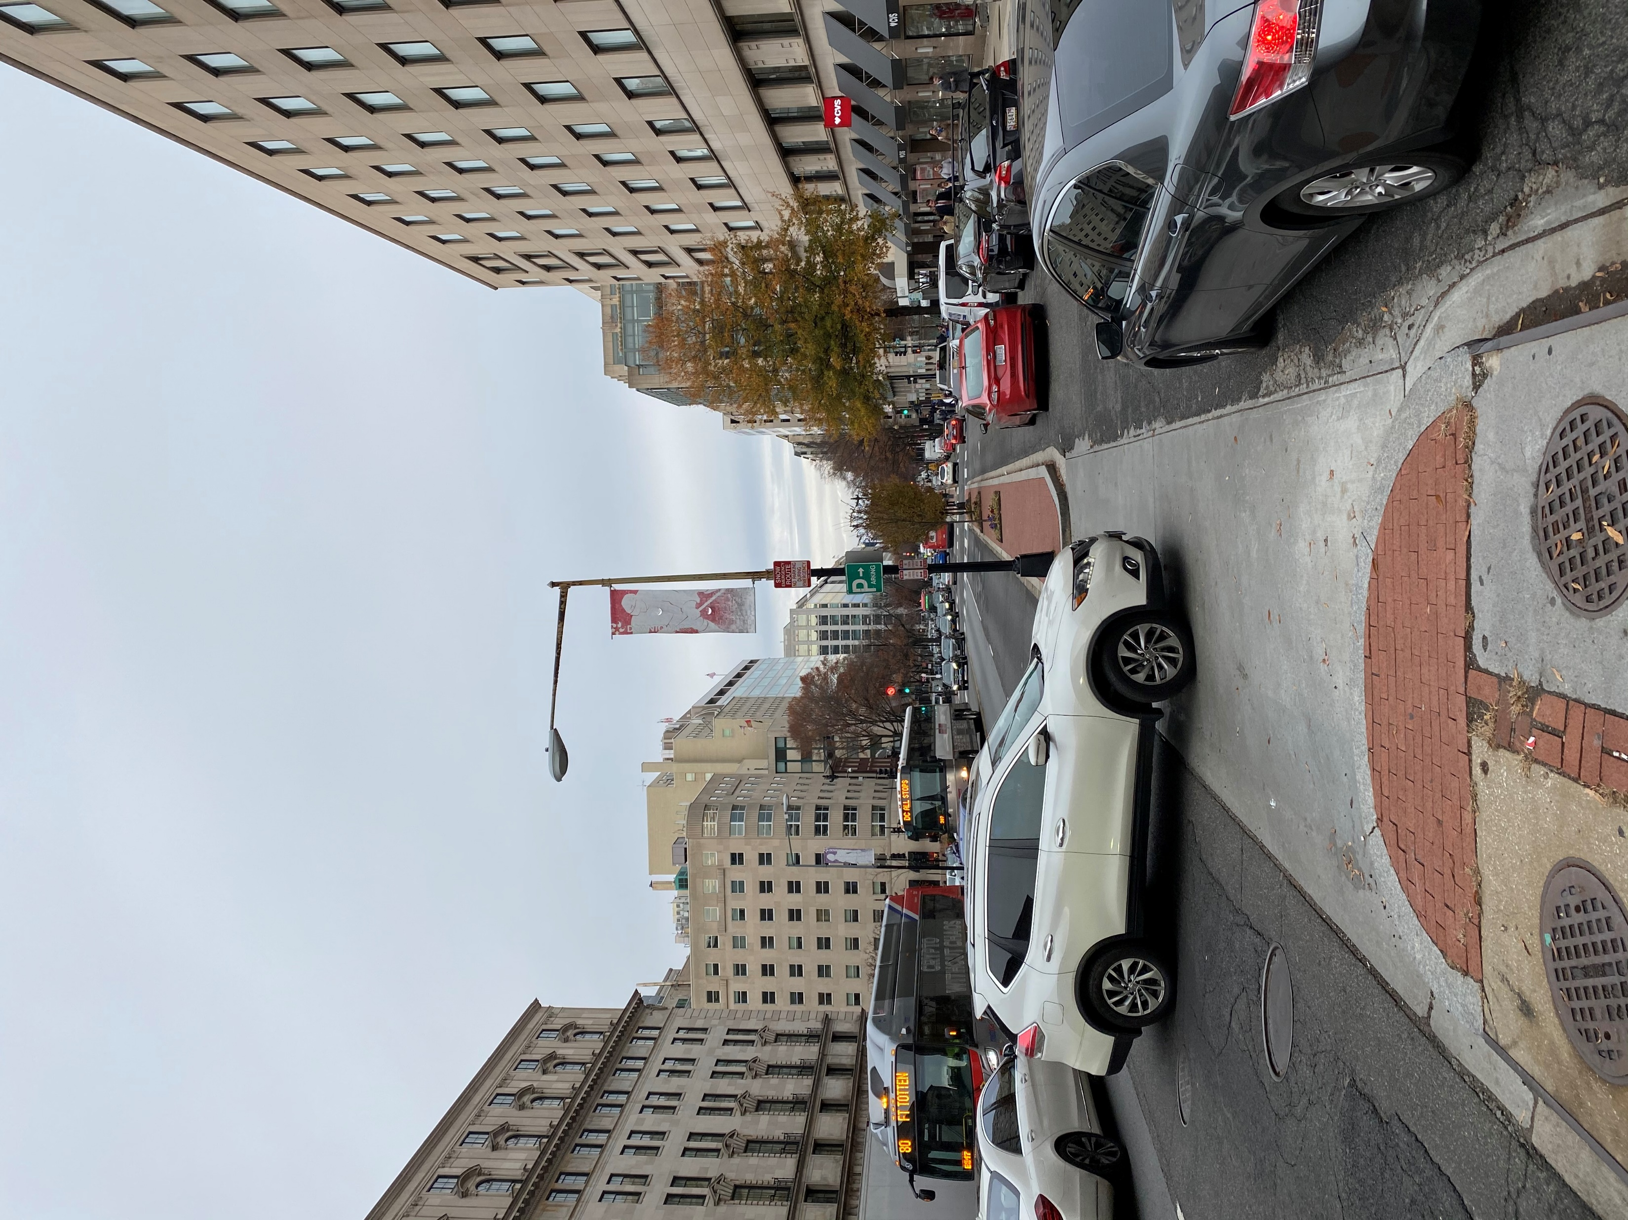

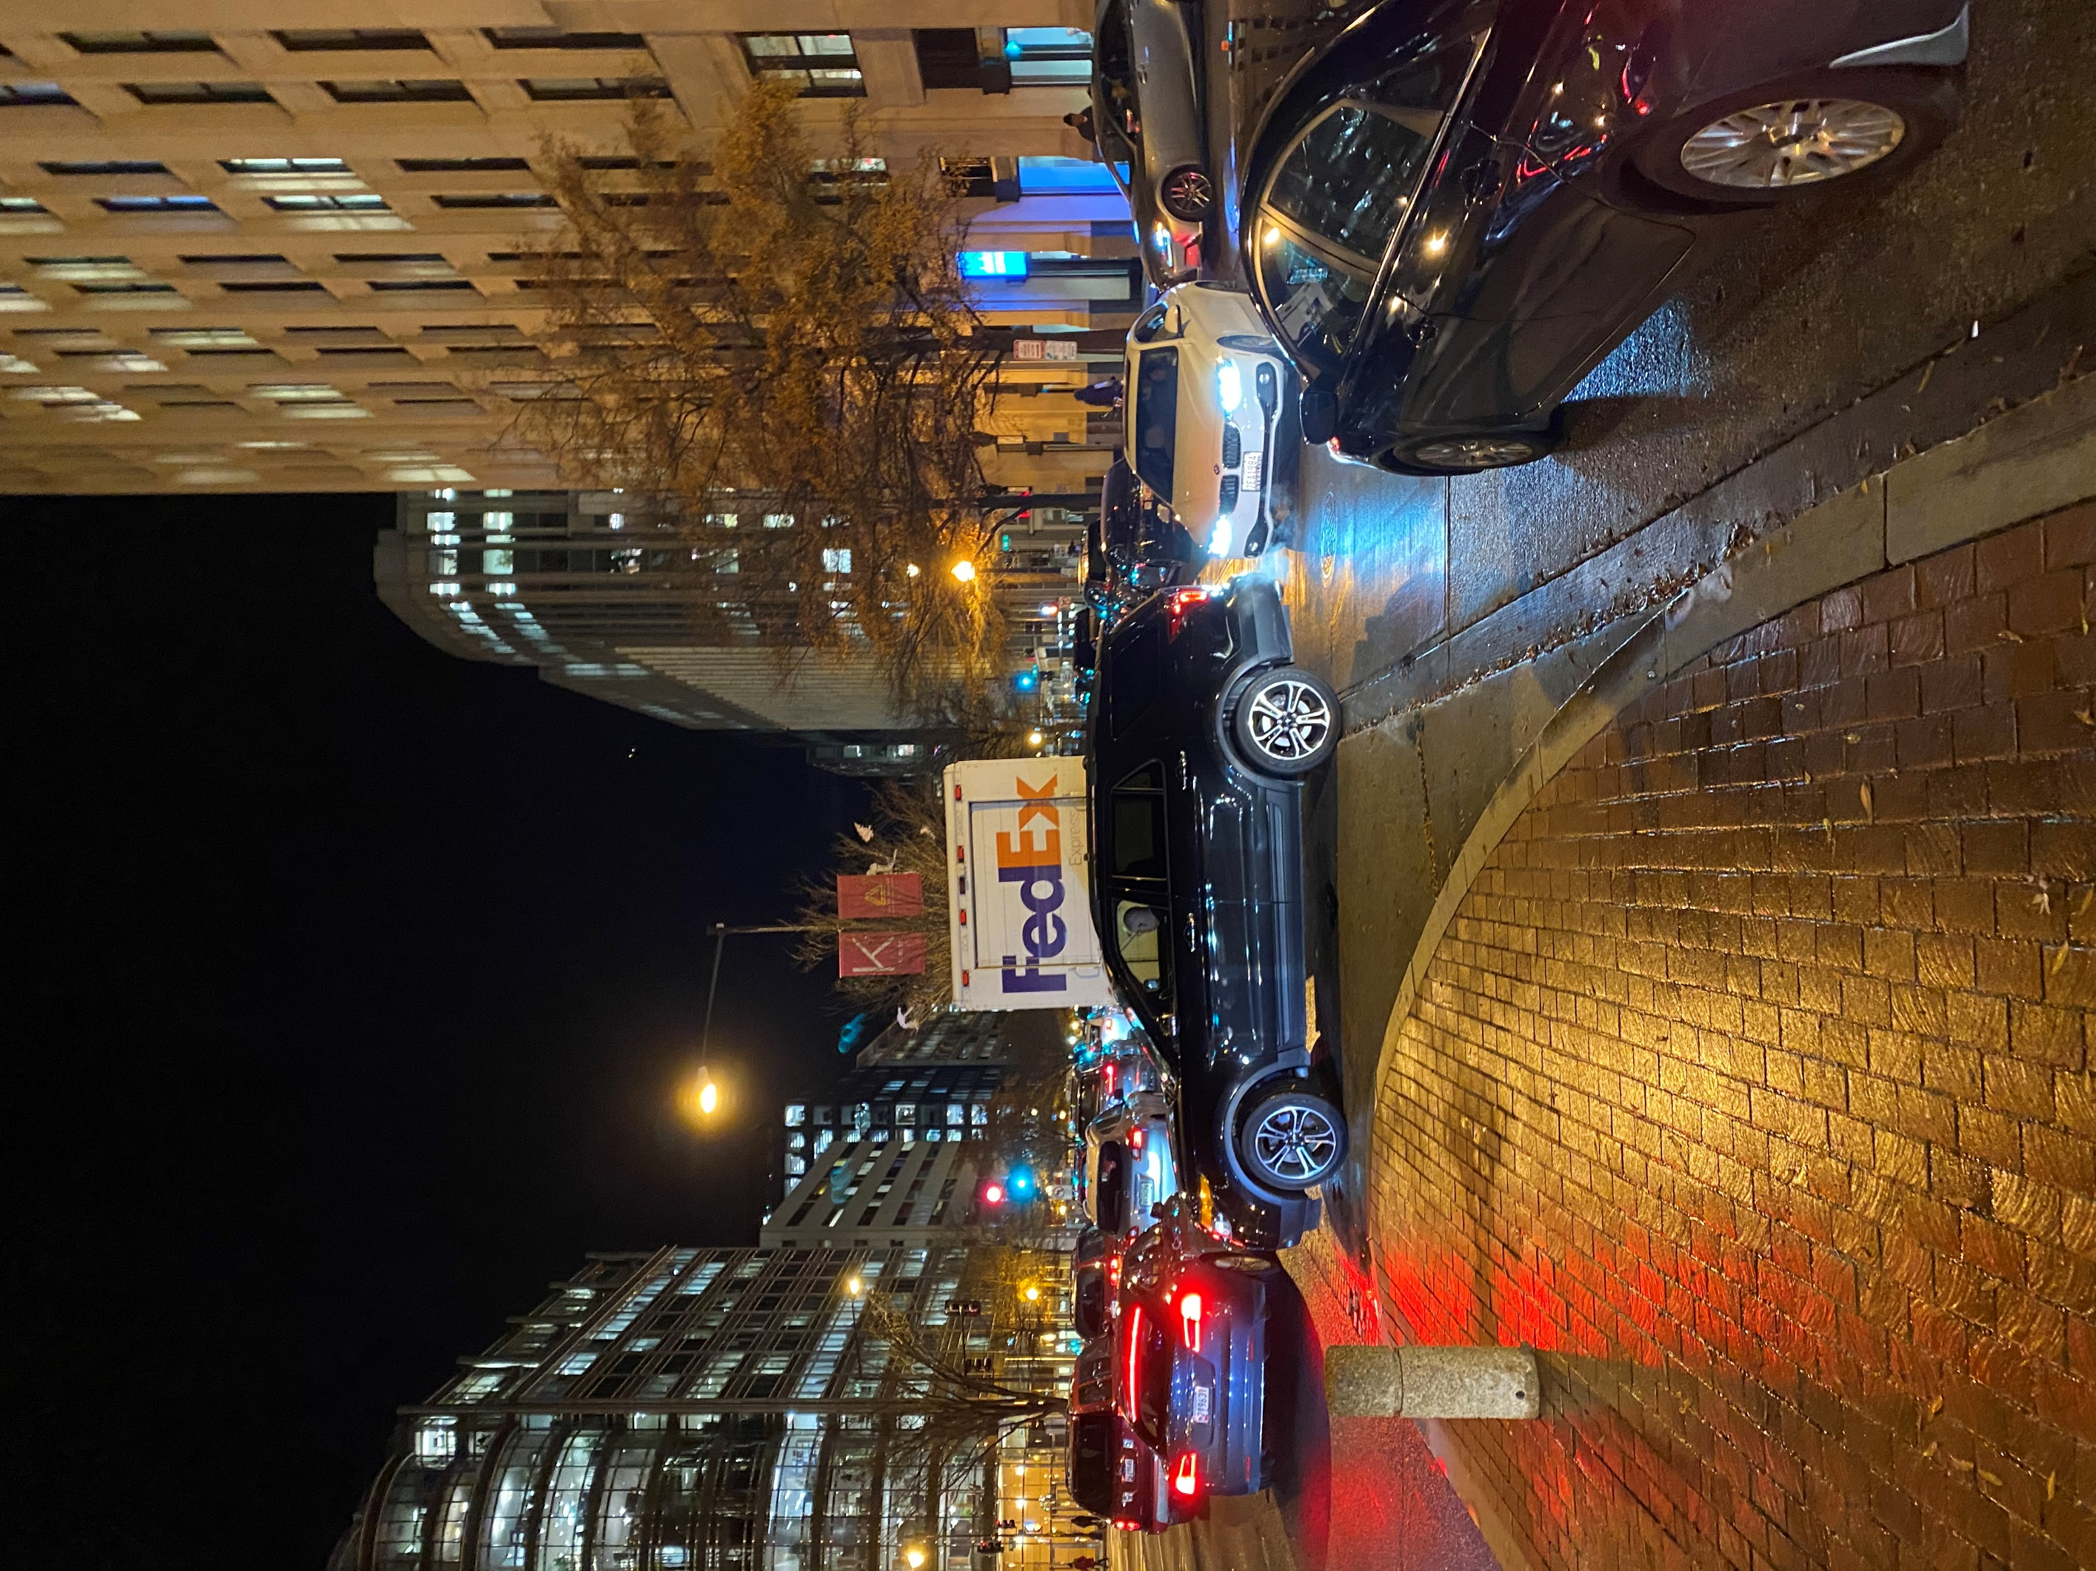
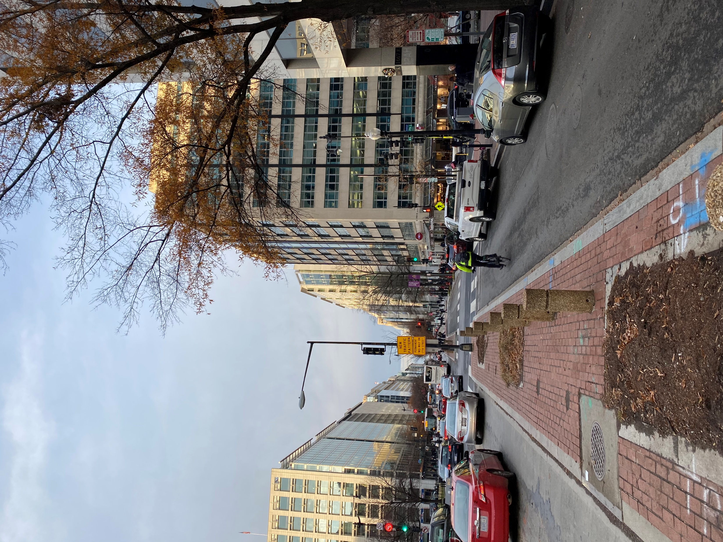
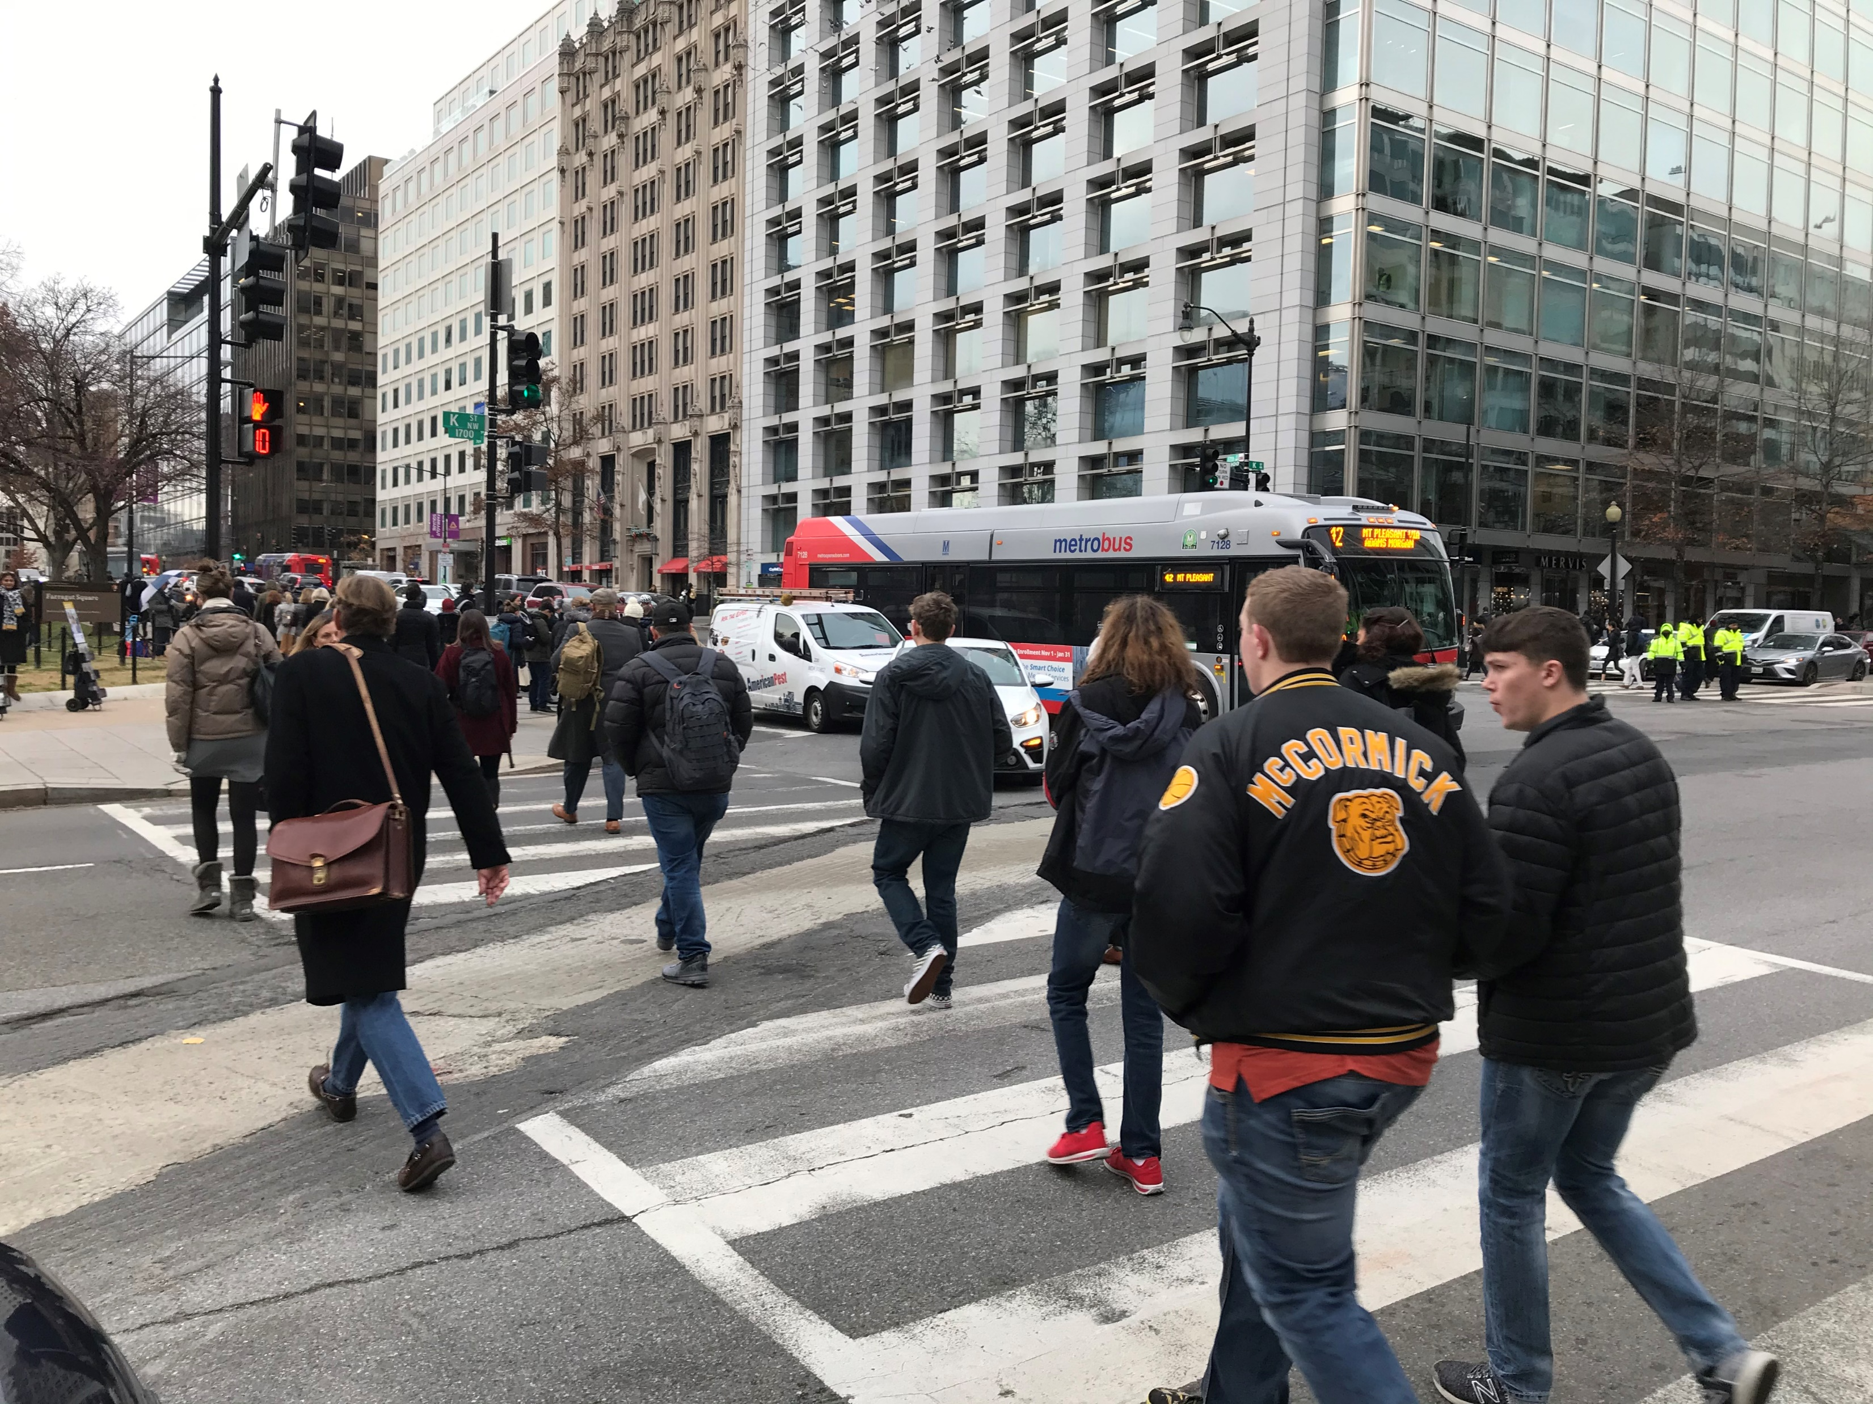
Data Collection
Bus bunching, Eastbound at 16th Street NW
Right-of-way confusion entering service lanes (AM)
Challenging egress from parking garages and navigating service lanes (PM) [note illegally parked FedEx truck in service lane access break]
Heavy pedestrian traffic outside the Farragut North Metrorail Station
Sporadic use of service lanes by bicycles

Slide 9

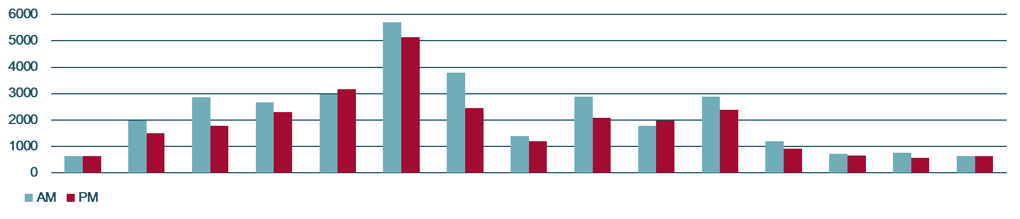
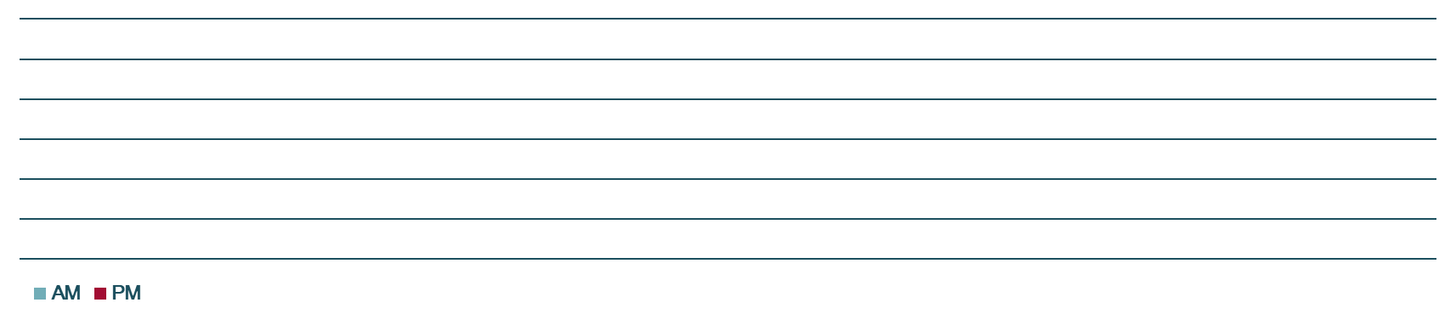
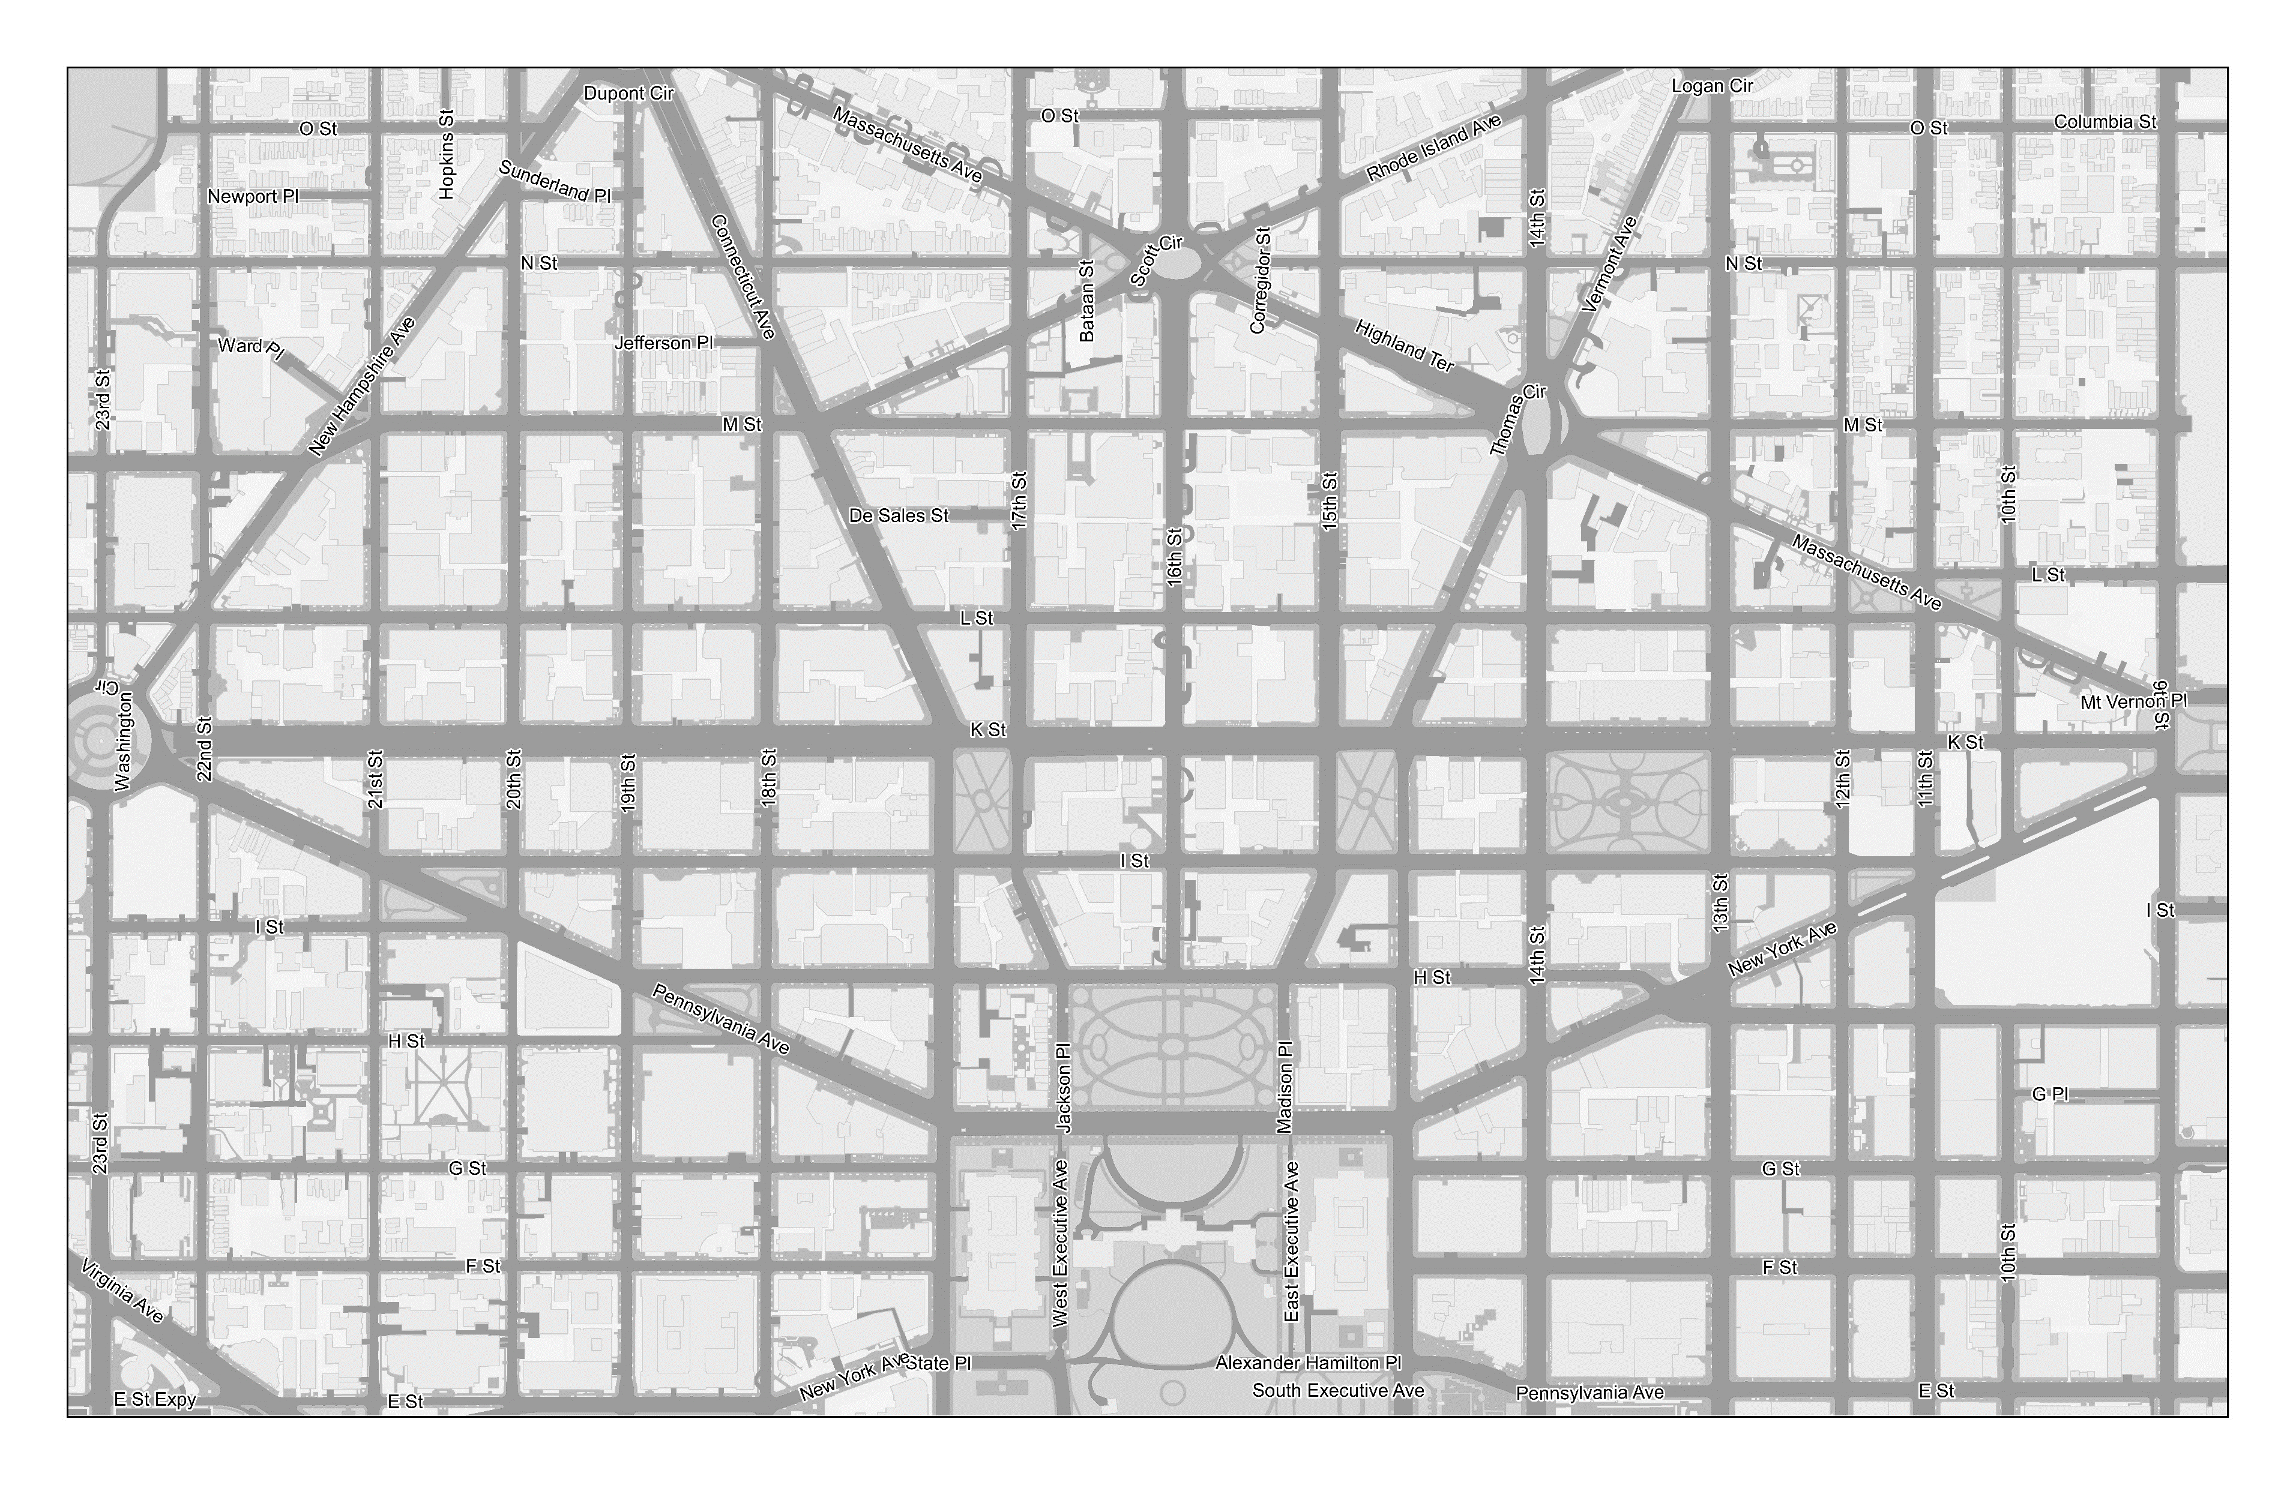

Data Collection
Total Pedestrian Crossings (AM and PM Peak Hour)*
941
749
761
923
491
456
170
160
AM PM Maximum Hourly Pedestrian Volume Across a Single Leg of the Intersection (pedestrian symbol scaled to represent magnitude of crossing volume)
1,471
713
1,680
1,516
##
##
*Traffic data collected on December 4, 2019

Slide 10

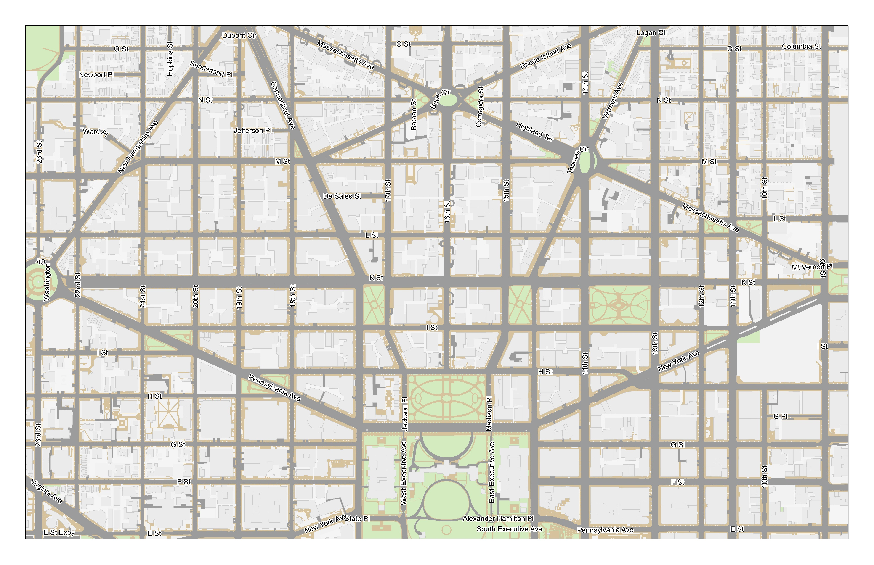

M
Bus Average Dwell Time
AM Peak
PM Peak
Average Dwell Time
17 sec
22 sec
WESTBOUND
Bus Stop Locations on K Street NW Mainline
K+20th
K+19th
K+18th
K+CT/17th
K+16th
K+15th
K+14th
K+13th
K+20th
K+19th
K+18th
K+CT
K+16th
K+15th
K+14th
K+13th
K+11th
Hot Spots with High Average Dwell Time
Average Dwell Time
AM Peak
PM Peak
K+20th
K+CT, EB
K+CT, WB
21 sec
22 sec
AM Peak
AM Peak
AM Peak
EASTBOUND
42 sec
40 sec
32 sec
* Transit dwell time distributions derived from WMATA AVL data.
* PM peak period average dwell times were consistent with one another, hot spots not identified.

Slide 11
Traffic Simulation Model

Slide 12










What is Traffic Simulation Modeling?
Simulates the presence and behavior of each individual user in the network
Records performance metrics for all network users and the network as a whole
Model is calibrated to real-world conditions
Enables the analysis of build alternatives in a future condition to inform design

Slide 13











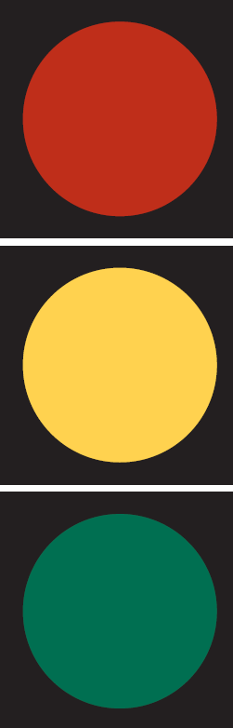
Benefits of Traffic Modeling
Understand modal interaction
Simulate driving behaviors
Calculate transit dwell time changes
Determine travel times
Replicate real-world congestion

Slide 14


Shortcomings of Traffic Modeling
Capturing surrounding network congestion
22
21
20
19
18
CT
17
16
15
VT
14
13
12
Accounting for trip diversions
M
L
K
Original Trip
I
Study Area
K St NW
H
Simulating prohibited curbside activity
I St NW
Trip Diversion
21st St NW
20th St NW
19th St NW
18th St NW
H St NW
Loading/Unloading

Slide 15
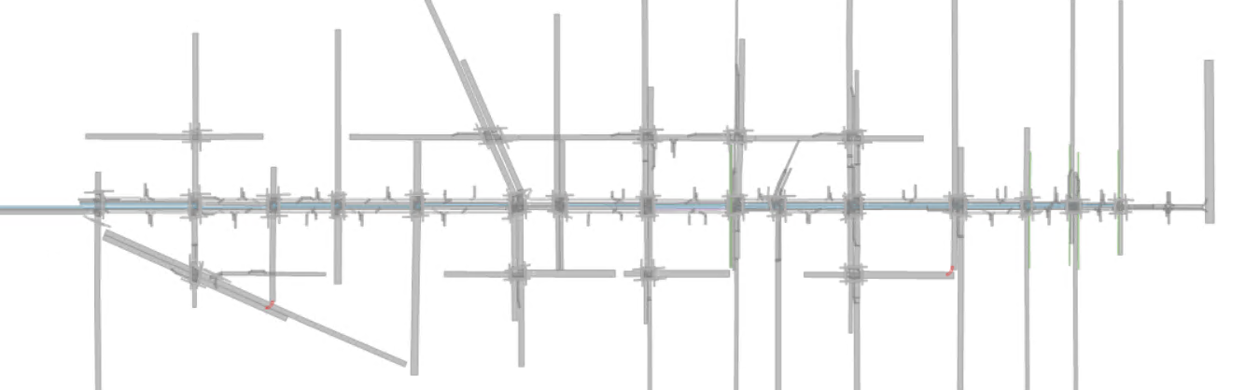
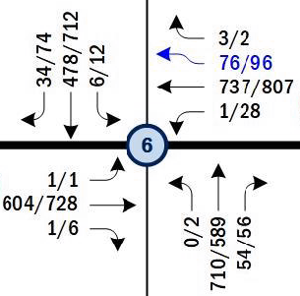

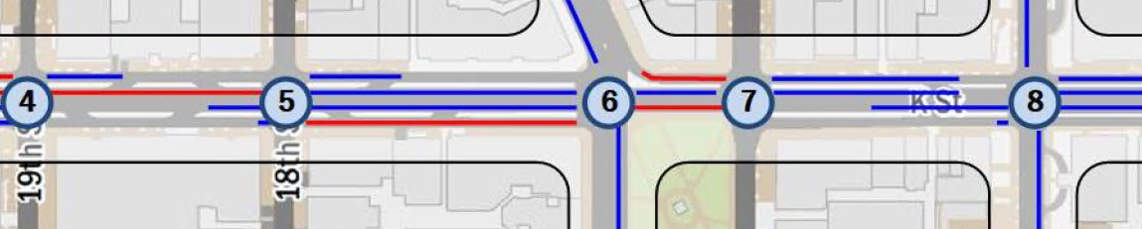

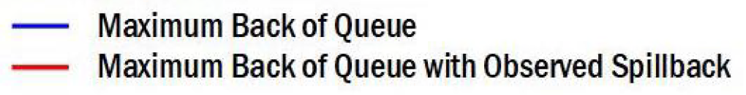
Building a Calibrated Model
Calibration is the adjustment of model parameters to represent real-world conditions
Corridor Travel Time
Vehicular Throughput
Queues & Bottlenecks
34
478
6
3
76
737
1
Traffic Counts
=
1
604
1
Simulated Counts
54
710
0

Slide 16
Analysis of Existing Network
Traffic operations reported from calibrated Vissim traffic model

Slide 17






Travel Time
AM Peak
PM Peak
AM Peak
PM Peak
7:08
7:33
7:21
9:37
EASTBOUND
WESTBOUND
12:56
15:08
12:31
14:03
EASTBOUND
WESTBOUND
Westbound Travel Time
Eastbound Travel Time
Notes:
Vehicles Existing Conditions AM – Average eastbound travel time = 7:08, Average westbound travel time = 7:21
Transit Existing Conditions AM – Average eastbound travel time = 12:56, Average westbound travel time = 12:31 (includes dwell time)
Vehicles Existing Conditions PM – Average eastbound travel time = 7:33, Average westbound travel time = 9:37
Transit Existing Conditions PM – Average eastbound travel time = 15:08, Average westbound travel time = 14:03 (includes dwell time)

Slide 18
Intersection Delay
0-35 Seconds of Delay
35-55 Seconds of Delay
Good
Poor
55-80 Seconds of Delay
80+Seconds of Delay
Delay [seconds]
AM / PM
Intersection Performance
Vermont Avenue NW
Connecticut Avenue NW
AM
PM
22nd Street NW
11th Street NW
9th Street NW
19th Street NW
18th Street NW
17th Street NW
16th Street NW
15^{h} Street NW
14th Street NW
13th Street NW
12th Street NW
10th Street NW
21st Street NW
20th Street NW
Notes:
Existing LOS AM/PM
Pie chart summarizing AM / PM - # of intersections in each category.
Key for coloring of circles.

Slide 19
Approach Delay
K Street NW and
21st Street NW
K Street NW and
Connecticut Avenue NW
K Street NW and
15th Street NW
Intersection Performance
AM
PM
AM
PM
AM
PM
AM
PM
Approach Performance
AM - ML
AM
AM
AM
AM
AM
AM
PM - ML
PM
PM
PM
PM
PM
AM - SL
PM - SL
PM
AM
PM
AM
PM
AM
PM
*ML: Mainline K Street NW (from tunnel) *SL: Service Lane (from Washington Circle)
0-35 Seconds of Delay
K Street NW and
Vermont Avenue NW
K Street NW and
14th Street NW (east)
K Street NW and
12^{h} Street NW
35-55 Seconds of Delay
Good
Poor
AM
PM
AM
PM
55-80 Seconds of Delay
80+Seconds of Delay
AM
AM
AM
AM
AM
AM
PM
PM
PM
PM
PM
PM
AM
PM
AM
PM
AM
PM

Slide 20




Slowest Speeds along Corridor
SPEED LIMIT
25
Connecticut Avenue NW
Vermont Avenue NW
AM Peak
AM Peak
5 mph
6 mph
4 mph
7 mph
22nd Street NW
17th Street NW
11th Street NW
21st Street NW
20th Street NW
19th Street NW
18th Street NW
16th Street NW
15^{h} Street NW
14th Street NW
13th Street NW
12th Street NW
10th Street NW
9th Street NW
PM Peak
Connecticut Avenue NW
Vermont Avenue NW
6 mph
4 mph
4 mph
6 mph
22nd Street NW
17th Street NW
11th Street NW
21st Street NW
20th Street NW
19th Street NW
18th Street NW
16th Street NW
15^{h} Street NW
14th Street NW
13th Street NW
12th Street NW
10th Street NW
9th Street NW
* Average travel speed approximated from reported travel time measurements. Estimate includes intersection delay and transit dwell time.
Notes:
Existing LOS AM/PM
Pie chart summarizing AM / PM - # of intersections in each category.
Key for coloring of circles.

Slide 21
Defining Two Build Alternatives

Slide 22


Define the Build Alternatives
Transitway entrance and exit locations
Existing bus routes and stop locations
Location of bus stops
Balance signal priority with safety and operations
Minimize increases in travel times
Removal of service lanes
Plan for loading and unloading zones
Mitigate turning conflicts with pedestrians
Safety and accessibility along corridor
Transitway access
Protection from right-turn conflicts
Accommodate crossing of K Street NW within a single signal cycle
Dedicated bicycle facility
Connection to existing and planned north-south bicycle facilities connected to K Street NW

Slide 23

Define the Build Alternatives
Alternative 1
Alternative 2
Minimal changes to existing bus routes
Preservation of general purpose traffic lanes
Limited loading/unloading zones on K Street NW
Consolidated entry/exit points for transit
Reduced number of general purpose traffic lanes
Increased loading/unloading zones on K Street NW
Both
Dedicated, center-running transitway with five transit stops
Dedicated bike facilities in the median
Left turns restricted

Slide 24
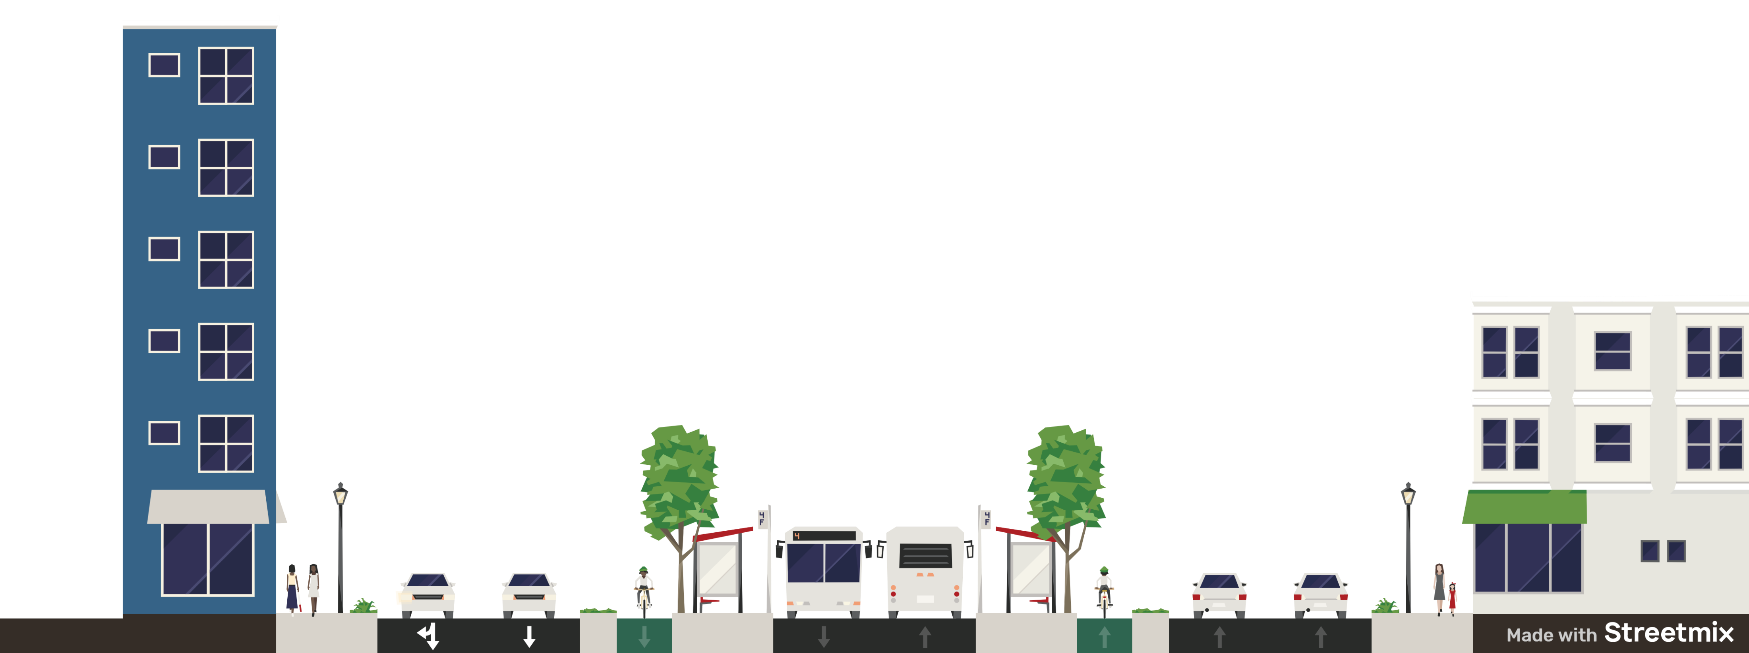
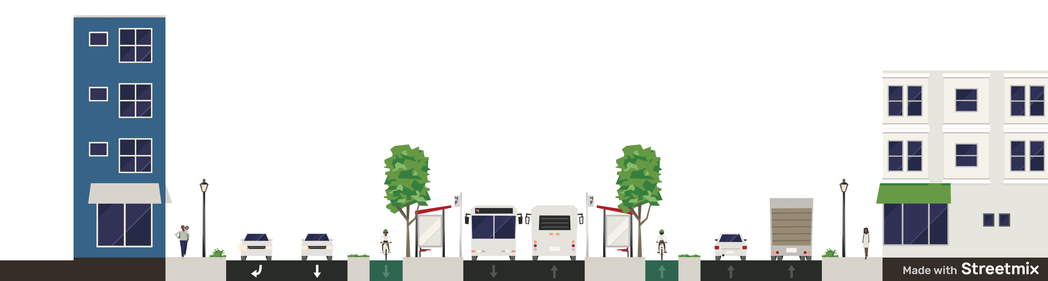
K Street NW Design Alternatives
Dedicated Bus Lanes
Variable
Width
Median
Platform and Median (not all blocks)
Protected Bike Lanes
1 through lane and 1 shared through and right-turn lane
2 through travel lanes (1 through lane and 1 shared through and right-turn lane)
1 through travel lane and
1 dedicated right-turn lane
1 through travel lane and 1 curb lane -- varied use as turn lane or loading
Alternative 1
Alternative 2

Slide 25


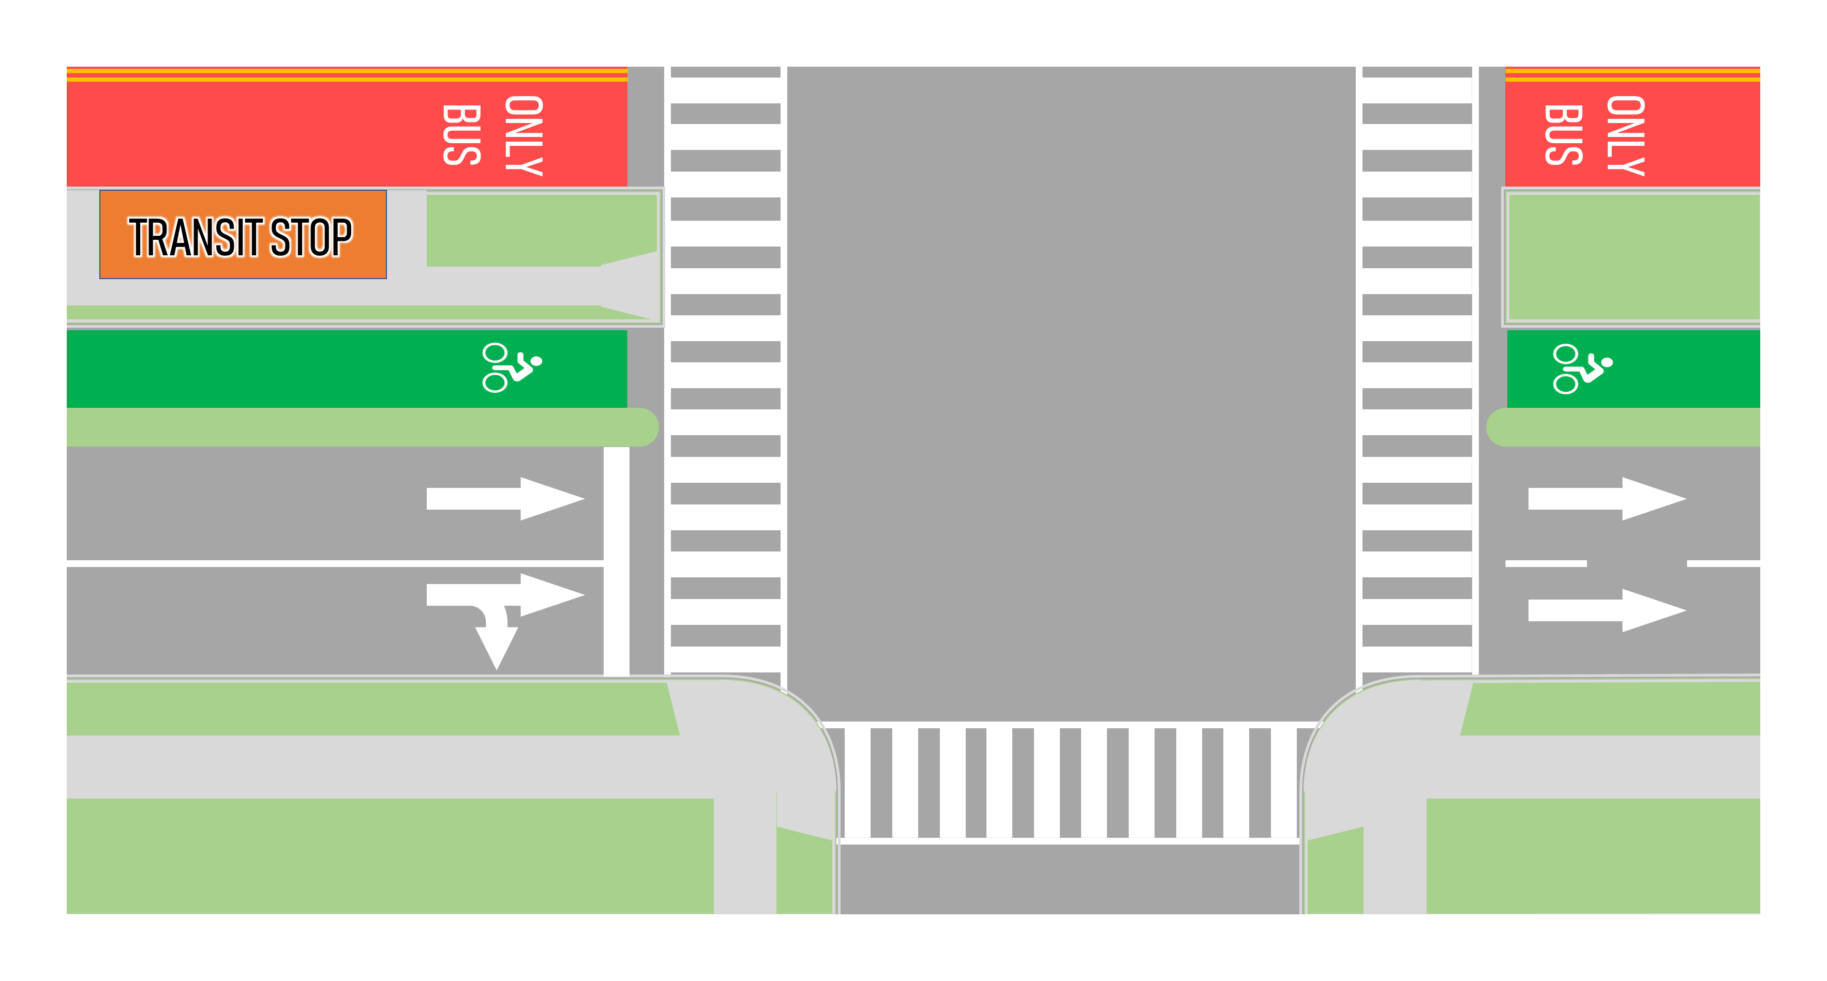
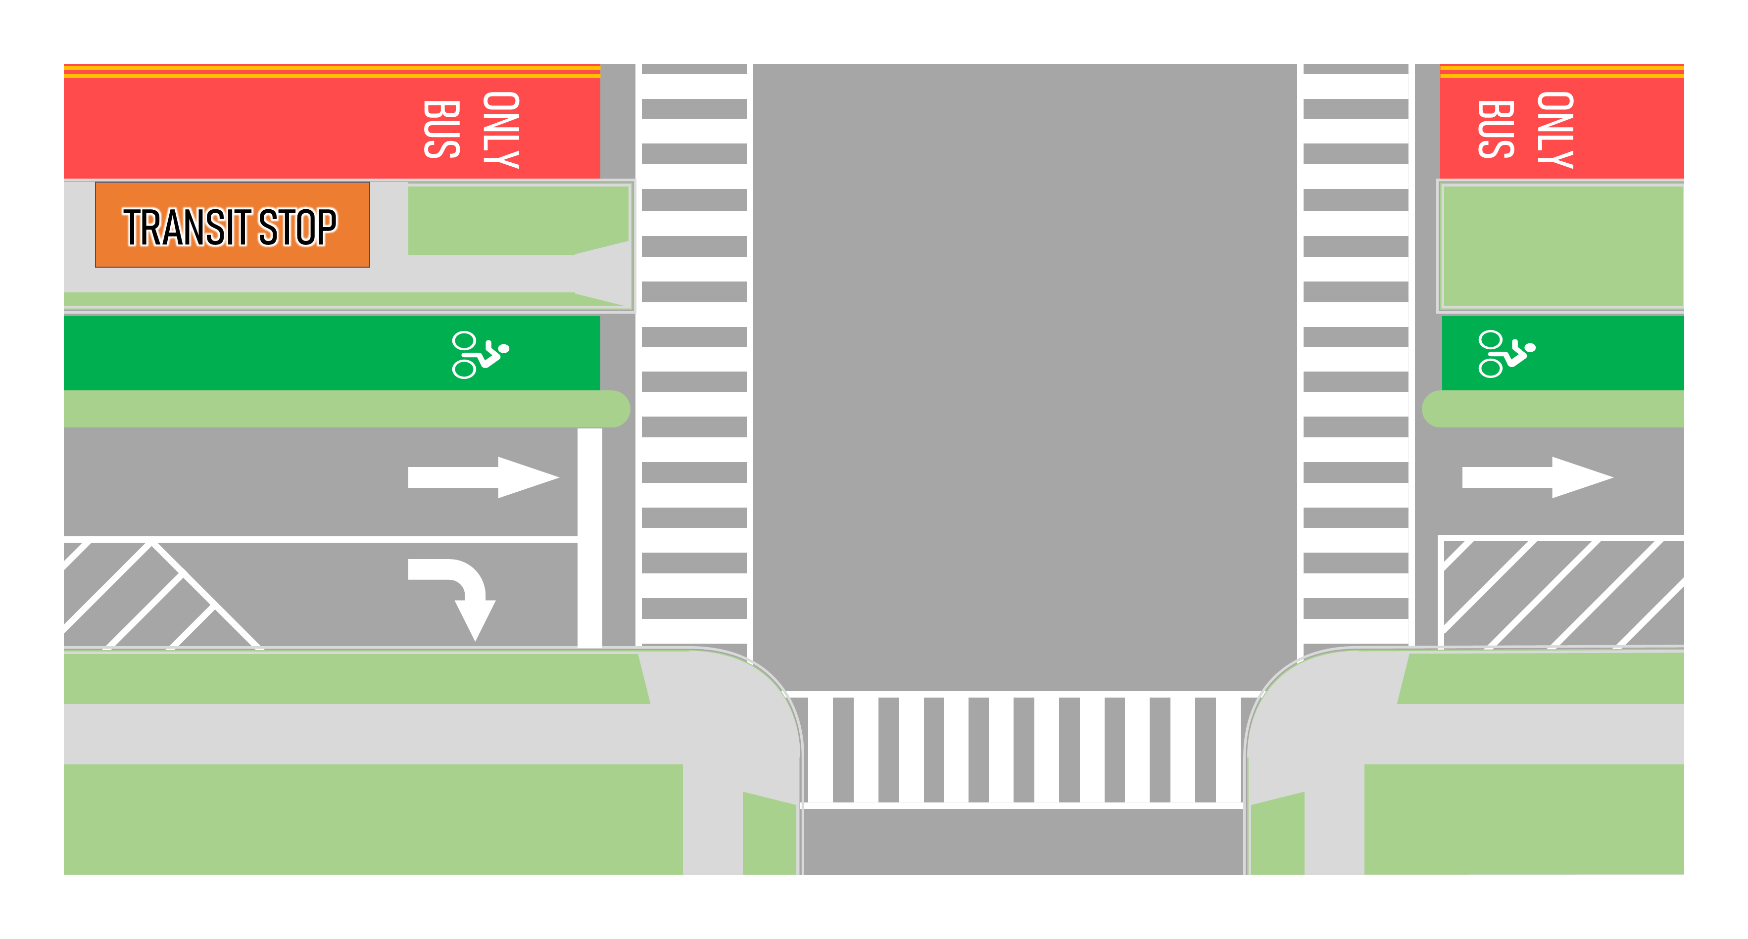
K Street NW Design Alternatives
Intersections
Transitway
Intersection Configurations
Alternative 1
Alternative 2

Slide 26



Transitway Access Options
Eastbound Westbound
Route Origin
Route Destination
USGT Circulator
Transitway
Transitway Entrance Only
Transitway Exit Only
Transitway Entrance/Exit
¹30N, 30S, 32, 33, 36, 37, 39
Alternative 1
Alternative 2
D6
D6
G8
G8
D6
D6
G8
G8
22nd
21st
20th
19th
18th
CT
17th
16th
15th
VT
14th
13th
12th
11th
10th
22nd
21st
20th
19th
18th
CT
17th
16th
15th
VT
14th
13th
12th
11th
10th
30s¹
30s¹
K STREET NW TRANSITWAY
K STREET NW TRANSITWAY
30s¹
30s¹
X2
X2
3Y
16Y
80
G8
3Y
16Y
80
G8
30s¹
3Y
16Y
30s¹
3Y
16Y
D6
X2
80
D6
X2
80
X2
80
G8
3Y
16Y
X2
80
G8
3Y
16Y
30s¹
30s¹
D6
X2
80
3Y
16Y
D6
X2
80
3Y
16Y
5 Entry/Exit Locations
4 Entry and 3 Exit Locations
Alternative 1 introduces more access points on and off the transitway on the west end of the network
Alternative 2 adjusts bus routing on the east end of the corridor to increase the number of buses utilizing the full transitway

Slide 27
Bus Dwell Time Assumptions
Average Dwell Time
AM Peak
PM Peak
AM Peak
Average Dwell Time
PM Peak
16 sec
16 sec
16 sec
16 sec
EASTBOUND
WESTBOUND
Bus Stop Locations on K Street Transitway
K+19th
K+CT
K+16th
K+14th
K+13th
Hot Spots with High Average Dwell Time
K+CT, EB
K+CT, WB
Notes:
Transit dwell time distributions for build conditions were derived from existing conditions dwell time distributions and reduced to reflect level-boarding, all-door boarding/alighting. The dwell time distributions were adjusted, this slide shows the resulting average dwell time.
The same reduced dwell-time distributions were applied in both alternatives.
Bus routes and schedules were adjusted in each build alternative according to the designated transitway entry and exit locations.
Due to these changes, more buses stop at each transitway stop as compared to individual stops in Existing Conditions and only WMATA and DC Circulator buses are allowed on the transitway. This contributes to the reported average dwell time.
PM peak period average dwell times were consistent with one another; hot spots were not identified.
AM Peak
AM Peak
30 sec
25 sec

Slide 28
Alternatives Analysis
Based on the poor performance of the PM peak period microsimulation model, the project team made the decision not to evaluate the AM peak period for Alternative 2

Slide 29



Travel Time
AM Peak
PM Peak
AM Peak
PM Peak
Alt 1
6:16
--
6:34
7:54
--
8:09
Alt 1
Alt 2*
14:11
14:17
Alt 2*
Alt 1
9:06
--
9:45
9:06
--
9:32
Alt 1
Alt 2*
9:31
9:33
Alt 2*
EASTBOUND
WESTBOUND
Existing
Alt 1
Alt 2*
* Alternative 2 analysis only performed for PM Peak Period
Notes:
Alt 1:
Vehicles Alternative 1 Conditions AM – Average eastbound travel time = 6:16, Average westbound travel time = 7:54
Transit Alternative 1 Conditions AM – Average eastbound travel time = 9:06, Average westbound travel time = 9:59 (includes dwell time)
Vehicles Alternative 1 Conditions PM – Average eastbound travel time = 6:34, Average westbound travel time = 8:09
Transit Alternative 1 Conditions PM – Average eastbound travel time = 9:45, Average westbound travel time = 9:32 (includes dwell time)
Alt 2:
Vehicles Alternative 2 Conditions AM – Average eastbound travel time = NA, Average westbound travel time = NA
Transit Alternative 2 Conditions AM – Average eastbound travel time = NA, Average westbound travel time = NA (includes dwell time)
Vehicles Alternative 2 Conditions PM – Average eastbound travel time = 14:11, Average westbound travel time = 14:17
Transit Alternative 2 Conditions PM – Average eastbound travel time = 9:31, Average westbound travel time = 9:33 (includes dwell time)

Slide 30
Intersection Delay
Good
Poor
AM
PM
Connecticut Avenue NW
Vermont Avenue NW
Existing
Alternative 1
Alternative 2*
22nd Street NW
11th Street NW
9th Street NW
19th Street NW
18th Street NW
17th Street NW
16th Street NW
15^{h} Street NW
14th Street NW
13th Street NW
12th Street NW
10th Street NW
21st Street NW
20th Street NW
* Alternative 2 analysis only performed for PM Peak Period

Slide 31
Approach Delay
Existing
Alternative 1
Alternative 2*
Intersection Performance
K Street NW and
21st Street NW
K Street NW and
21st Street NW
K Street NW and
21st Street NW
AM
PM
AM
PM
AM
PM
PM
Approach Performance
21st Street
AM
AM - ML
AM
AM - ML
AM
PM - ML
PM
PM - ML
PM
PM - ML
PM
PM
AM - SL
AM - SL
PM - SL
PM - SL
PM - SL
AM
PM
AM
PM
AM
PM
ML: Mainline K Street NW (from tunnel) SL: Service Lane (from Washington Circle)
0-35 Seconds of Delay
K Street NW and
Connecticut Avenue NW
K Street NW and
Connecticut Avenue NW
K Street NW and
Connecticut Avenue NW
35-55 Seconds of Delay
Good
Poor
AM
PM
AM
PM
PM
55-80 Seconds of Delay
Connecticut Ave
80+Seconds of Delay
AM
AM
PM
PM
PM
AM
PM
AM
PM
PM
* Alternative 2 analysis only performed for PM Peak Period

Slide 32
Approach Delay
Existing
Alternative 1
Alternative 2*
Intersection Performance
K Street NW and
15th Street NW (west)
K Street NW and
15th Street NW (west)
K Street NW and
15th Street NW (west)
AM
PM
AM
PM
AM
PM
PM
Approach Performance
15th Street
AM
AM
AM
AM
AM
PM
PM
PM
PM
PM
PM
PM
AM
PM
AM
PM
PM
0-35 Seconds of Delay
K Street NW and
Vermont Avenue NW
K Street NW and
Vermont Avenue NW
K Street NW and
Vermont Avenue NW
35-55 Seconds of Delay
AM
PM
AM
PM
PM
Good
Poor
Vermont Ave
55-80 Seconds of Delay
AM
AM
AM
AM
PM
PM
PM
80+Seconds of Delay
PM
PM
PM
AM
PM
AM
PM
PM
* Alternative 2 analysis only performed for PM Peak Period

Slide 33
Approach Delay
Existing
Alternative 1
Alternative 2*
Intersection Performance
K Street NW and
14th Street NW
K Street NW and
14th Street NW
K Street NW and
14th Street NW
AM
PM
AM
PM
AM
PM
PM
Approach Performance
14th Street
AM
AM
AM
AM
AM
PM
PM
PM
PM
PM
PM
PM
AM
PM
AM
PM
PM
0-35 Seconds of Delay
K Street NW and
12^{h} Street NW
K Street NW and
12^{h} Street NW
K Street NW and
12^{h} Street NW
35-55 Seconds of Delay
Good
Poor
12th Street
55-80 Seconds of Delay
AM
AM
AM
AM
PM
PM
PM
PM
80+Seconds of Delay
PM
PM
AM
PM
AM
PM
PM
* Alternative 2 analysis only performed for PM Peak Period

Slide 34
Slowest Speeds along Corridor
SPEED LIMIT
25
* Average travel speed approximated from reported travel time measurements. Estimate includes intersection delay and transit dwell time.
AM Peak
Connecticut Avenue NW
Vermont Avenue NW
6 mph
5 mph
6 mph
5 mph
AM Peak
4 mph
7 mph
6 mph
8 mph
22nd Street NW
17th Street NW
11th Street NW
21st Street NW
20th Street NW
19th Street NW
18th Street NW
16th Street NW
15^{h} Street NW
14th Street NW
13th Street NW
12th Street NW
10th Street NW
9th Street NW
Existing
Alternative 1
Alternative 2*
PM Peak
2 mph
6 mph
Connecticut Avenue NW
Vermont Avenue NW
5 mph
6 mph
6 mph
4 mph
4 mph
6 mph
10 mph
6 mph
22nd Street NW
2 mph
17th Street NW
6 mph
11th Street NW
21st Street NW
20th Street NW
19th Street NW
18th Street NW
16th Street NW
15^{h} Street NW
14th Street NW
13th Street NW
12th Street NW
10th Street NW
9th Street NW
* Alternative 2 analysis only performed for PM Peak Period
Notes:
Existing LOS AM/PM
Pie chart summarizing AM / PM - # of intersections in each category.
Key for coloring of circles.

Slide 35



Alternative 1
Alternative 2
Pros and Cons for Both Alternatives 1 & 2
PROS
CONS
Center-running exclusive transitway for WMATA & DC Circulator buses
Center-running dedicated bicycle lanes
Safety benefits from restricted left-turns on K Street NW
Removal of K Street NW service lanes
Right-in/right-out access at all existing alleys and garages
Rerouted left-turning movements to parallel facilities
Additional travel time delay for rerouted left-turns (note that existing peak period operations restrict left turns at most intersections)
Removal of K Street NW service lanes results in reduced curb space for loading and unloading

Slide 36
Minimal impact to existing bus routes by allowing transitway entry and exit at 5 intersections
Transit travel time improvements (-20% to -36%) compared to existing
In most cases vehicle travel time improvements:
AM eastbound: -12%
AM westbound: -13%
PM eastbound: -15%
Pros and Cons Specific to Alternative 1
Alternative 1
PROS
CONS
Minimal impact to existing bus routes by allowing transitway entry and exit at 5 intersections
Transit travel time improvements (-20% to -36%) compared to existing
In most cases vehicle travel time improvements:
AM eastbound: -12%
AM westbound: -13%
PM eastbound: -15%
Modest increase in vehicle travel time in one direction:
PM westbound: +7%
Limited right-of-way at Farragut Square for two through lanes
Limited curb space for loading and unloading
Added transitway exit locations (19th Street NW and 20th Street NW) limits transit travel time reductions in the westbound direction
Pros
Cons
Slight increase in vehicle travel time in one direction:
PM westbound: +7%
Transitway entry and exit design limits transit travel time reductions in the westbound direction
Limited right-of-way at Farragut Square for two through lanes
Limited curb space for loading and unloading

Slide 37
Constructible cross-section based on right-of-way constraints at Farragut square
Increased curb space for loading and unloading
Introduced dedicated eastbound right-turn lane at 19th Street NW
Streamline transitway performance by only allowing transitway entry and exit at 3 intersections
Transit travel time improvements (-32% to -37%) compared to existing (PM only)
Pros and Cons Specific to Alternative 2
Alternative 2
PROS
CONS
Transit travel time improvements (-32% to -37%) compared to existing (PM)
Constructible cross-section based on right-of-way constraints at Farragut square
Increased curb space for loading and unloading
Introduced dedicated eastbound right-turn lane at 19th Street NW
Streamline transitway performance by only allowing transitway entry and exit at 3 intersections
Through-vehicle demand for K Street NW during the PM peak is too high for a single lane to service
Greater bus route impacts to existing bus routes with limited transitway access points
The observed increase of vehicle travel time compared to existing (+49% to +88%) does not account for the high unserved demand of 25% (i.e., vehicles unable to make their trip during the peak period)
Transitway performance also impacted by vehicular delay, limiting signal timing optimization options and increasing incurred delay of buses prior to entering the transitway
Pros
Cons
Through-vehicle demand for K Street NW during the PM peak is too high for a single lane to service
Route impacts to existing bus routes based on limited transitway access
The observed increase of vehicle travel time compared to existing (+49% to +88%) does not account for the high unserved demand of 25% (i.e., vehicles unable to make their trip during the peak period)
Transitway performance also impacted by vehicular delay, limiting signal timing optimization options and increasing incurred delay of buses prior to entering the transitway.

Slide 38
Development of the Hybrid Alternative

Slide 39

Hybrid Alternative Design
Alt 1 Design
Alternative 1
Hybrid Design
Westbound Approach – Alt 1
Eastbound Approaches – Alt 2
Transitway
Alternative 2

Slide 40
Hybrid Alternative Design
22nd
21st
20th
19th
18th
CT
17th (E)
16th
15th (W)
14th
13th
12th
11th
VT
10th
22nd
21st
20th
19th
18th
17th (W)
17th (E)
16th
15th (W)
15th (E)
14th
13th
12th
11th
10th
Lane Drop
Lane Drop
Legend: Center Line Transitway Stop Direction of Cross Street Transit Lane
Bike Lane Travel Lane Service Lane

Slide 41

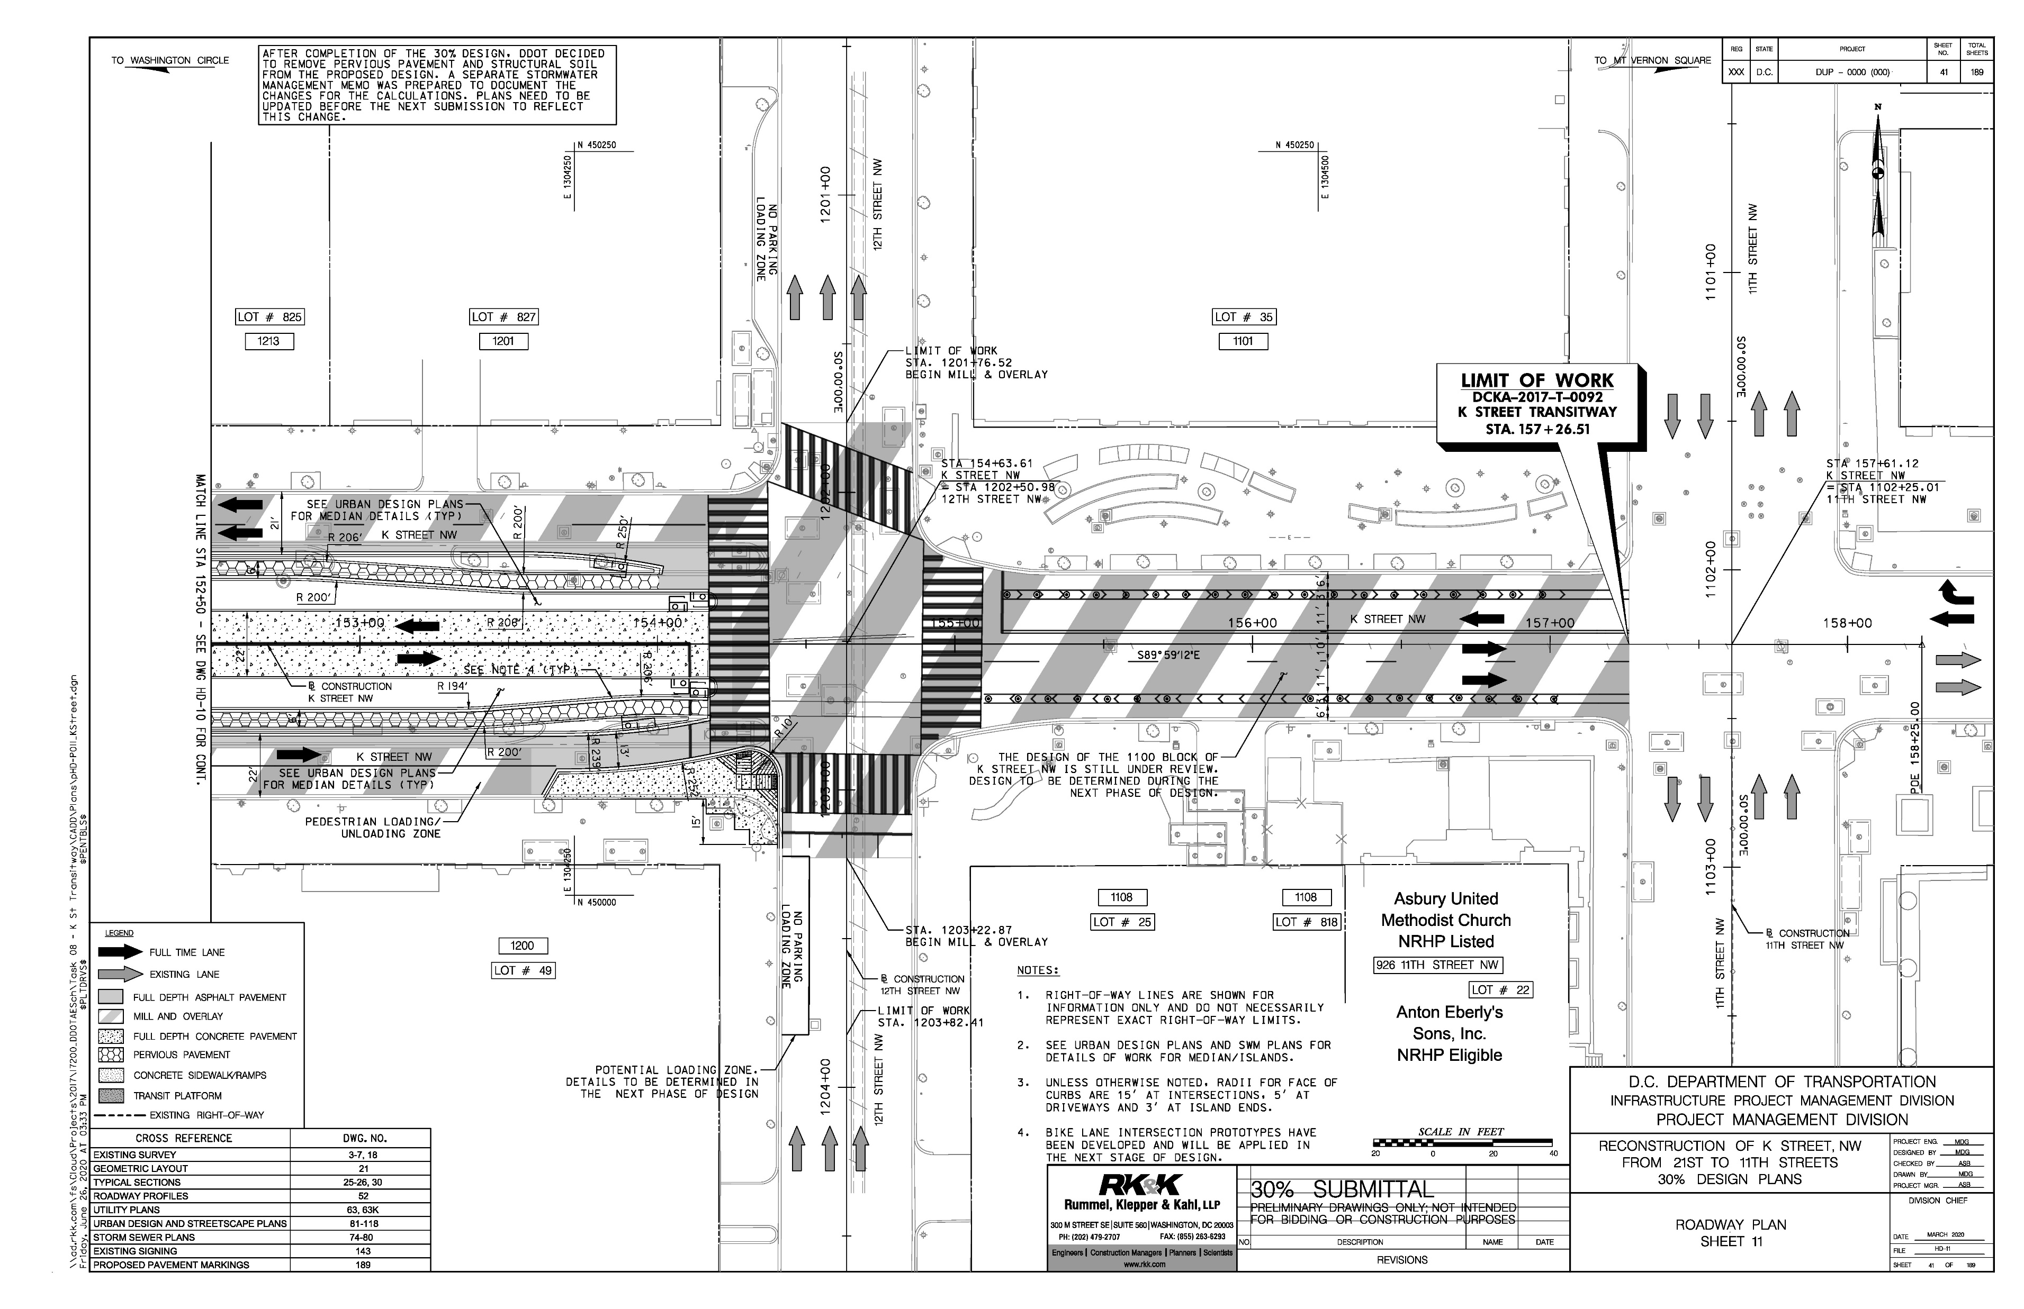
1100-1200 Block of K Street NW
30% design for eastern terminus of Transitway at 12th Street NW
N
NOT TO
SCALE

Slide 42
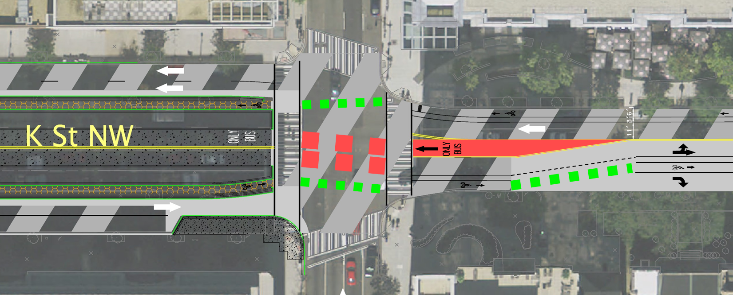
1100-1200 Block of K Street NW
Alternate design for eastern terminus of Transitway at 12th Street NW
Westbound bicycles operate during the eastbound queue jump phase
Westbound buses operate concurrently with general purpose traffic and during the eastbound queue jump phase
Dedicated transitway entry lane for westbound buses
Eastbound buses and bicycles operate at the same time during a dedicated queue jump phase
Dedicated eastbound right-turn lane allows for overlap signal operations, providing additional green time for turning buses
N
NOT TO
SCALE

Slide 43
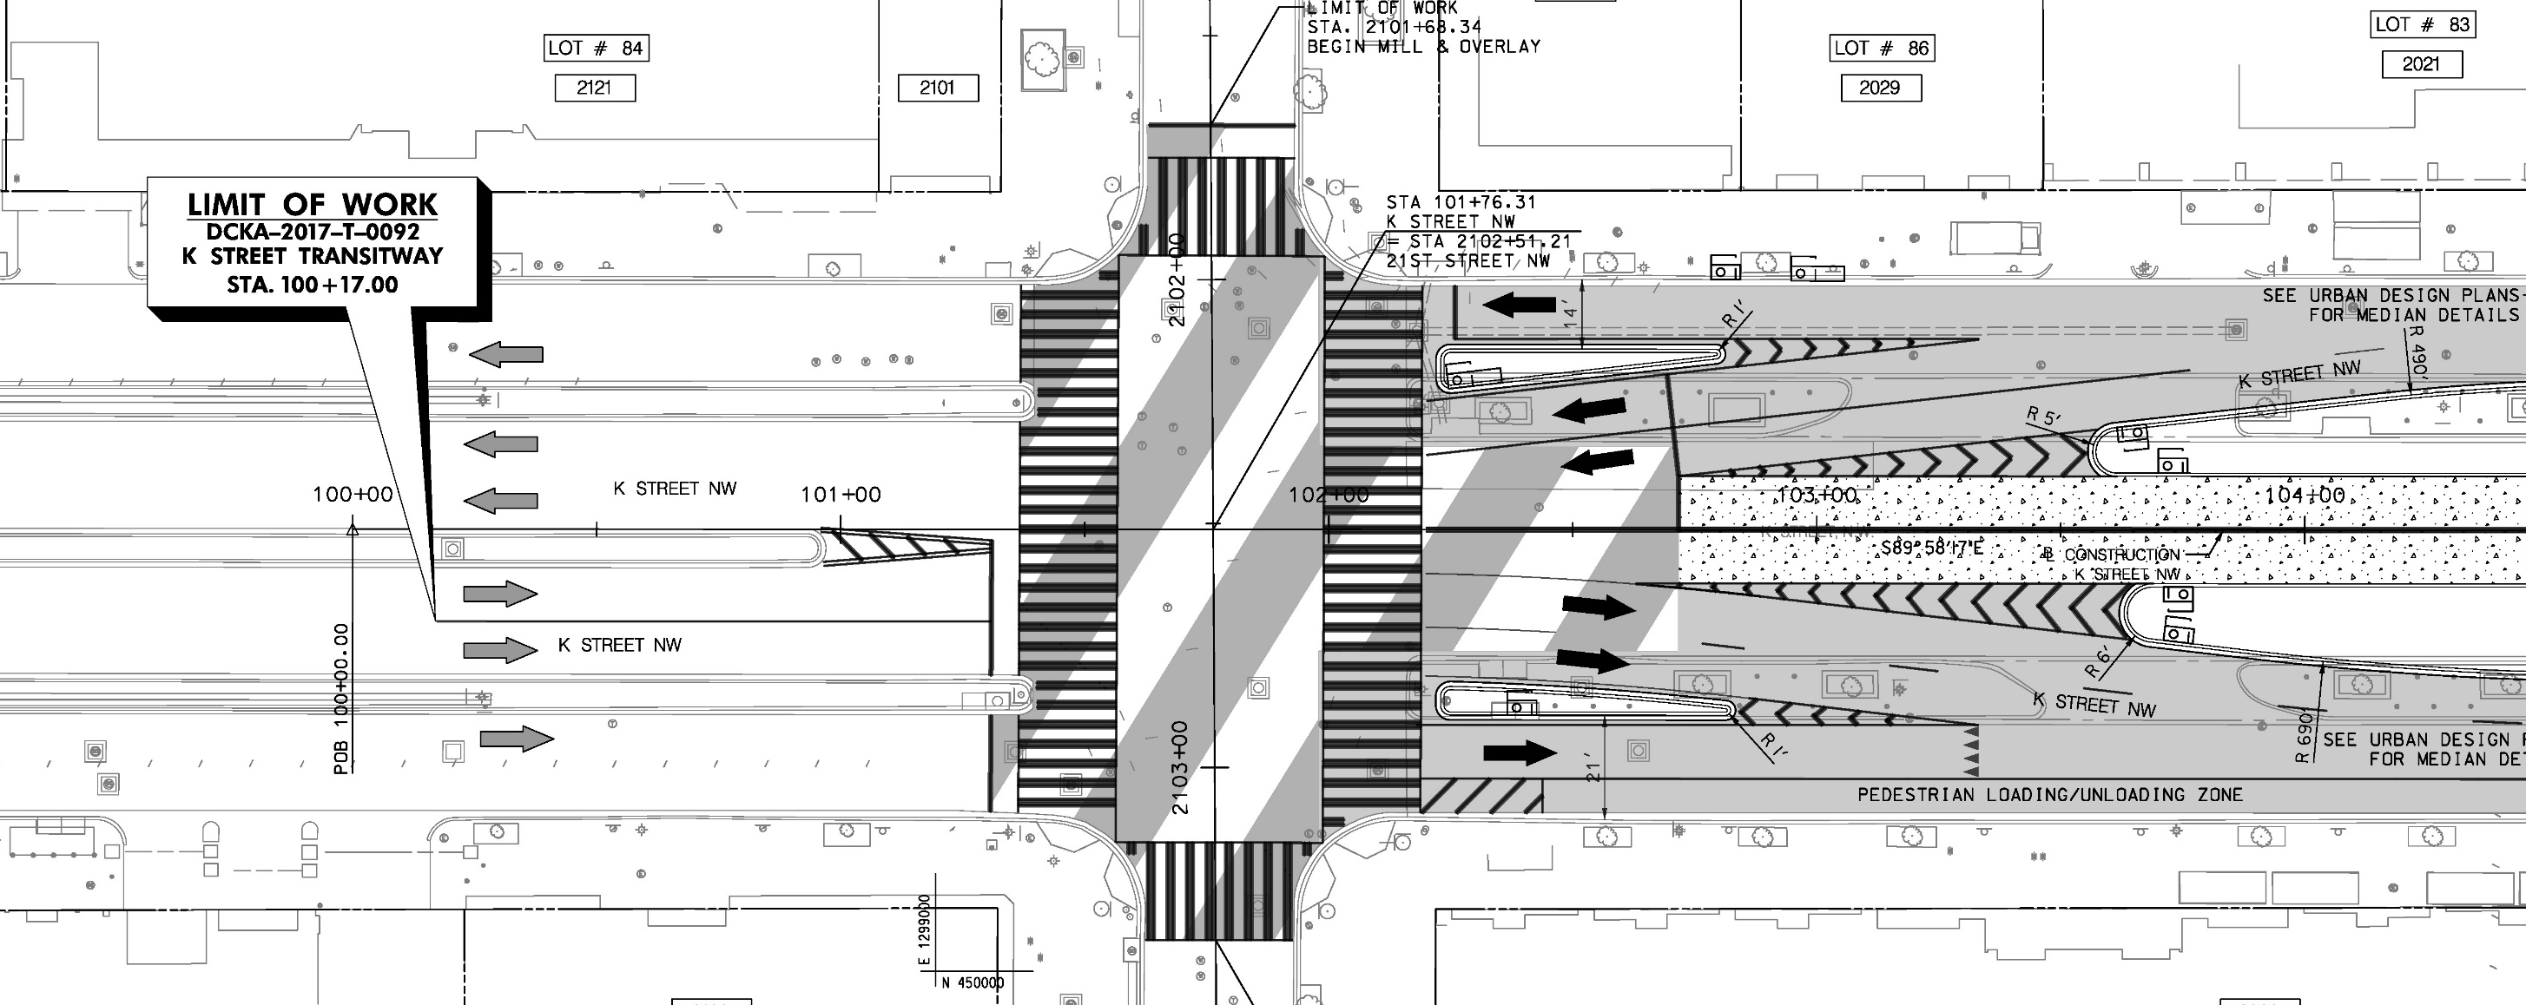
2000-2100 Block of K Street NW
30% design for western terminus of Transitway at 21st Street NW
N
NOT TO
SCALE

Slide 44
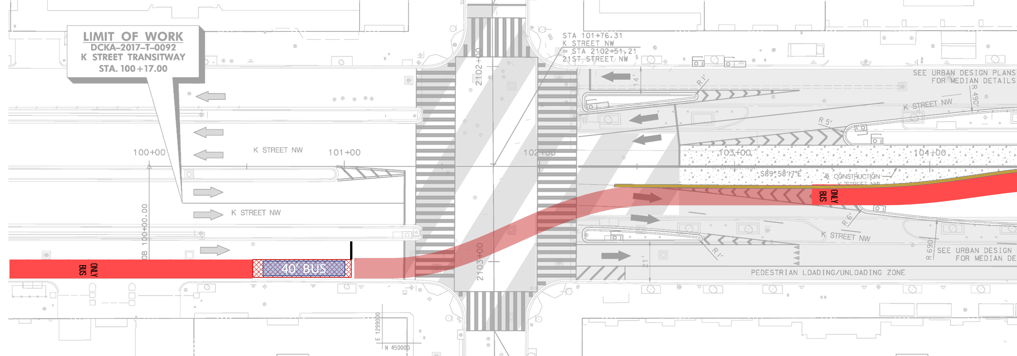
2000-2100 Block of K Street NW
Alternative design for western terminus of Transitway at 21st Street NW – Eastbound Option 2
N
NOT TO
SCALE
Moving the transitway dwell area to the curb positions the bus in an expected location and eliminates a potential sight distance obstruction for permissive westbound left-turning buses (see later exhibit)
Shift in eastbound transitway entry lane to accommodate alternative design for westbound exit (see later exhibit)
Rush-hour restricted transit-only queue jump lane; optional curbside parking lane outside rush hour
Adjust service lane stop bar location
Transit-only travel lane
Transit vehicle travel path (transition to/from the Transitway)
Element of Design Option
Transitway entrance dwell area
Benefit of Design Option

Slide 45
Hybrid Alternative Performance

Slide 46
Travel Time
AM Peak
PM Peak
AM Peak
PM Peak
Exist.
7:08
6:01
7:33
9:25
7:21
6:09
9:37
6:40
Exist.
Hybrid
Hybrid
Exist.
12:56
8:07
15:08
8:29
12:31
8:01
14:03
7:35
Exist.
Hybrid
Hybrid
EASTBOUND
WESTBOUND
Existing
Hybrid
Notes:
Alt 1:
Vehicles Alternative 1 Conditions AM – Average eastbound travel time = 6:16, Average westbound travel time = 7:54
Transit Alternative 1 Conditions AM – Average eastbound travel time = 9:06, Average westbound travel time = 9:59 (includes dwell time)
Vehicles Alternative 1 Conditions PM – Average eastbound travel time = 6:34, Average westbound travel time = 8:09
Transit Alternative 1 Conditions PM – Average eastbound travel time = 9:45, Average westbound travel time = 9:32 (includes dwell time)
Alt 2:
Vehicles Alternative 2 Conditions AM – Average eastbound travel time = NA, Average westbound travel time = NA
Transit Alternative 2 Conditions AM – Average eastbound travel time = NA, Average westbound travel time = NA (includes dwell time)
Vehicles Alternative 2 Conditions PM – Average eastbound travel time = 14:11, Average westbound travel time = 14:17
Transit Alternative 2 Conditions PM – Average eastbound travel time = 9:31, Average westbound travel time = 9:33 (includes dwell time)

Slide 47
Intersection Delay
Good
Poor
AM
PM
Connecticut Avenue NW
Vermont Avenue NW
Existing
Hybrid Alternative
22nd Street NW
11th Street NW
9th Street NW
19th Street NW
18th Street NW
17th Street NW
16th Street NW
15^{h} Street NW
14th Street NW
13th Street NW
12th Street NW
10th Street NW
21st Street NW
20th Street NW

Slide 48
Approach Delay
21st Street
CT Avenue
15th Street
Intersection Performance
K Street NW and
21st Street NW
K Street NW and
Connecticut Avenue NW
K Street NW and
15th Street NW (west)
AM
PM
AM
PM
AM
PM
AM
PM
Approach Performance
Existing
AM
AM - ML
AM
AM
AM
AM
AM
PM - ML
PM
PM
PM
PM
PM
PM
AM - SL
PM - SL
AM
PM
AM
PM
AM
PM
0-35 Seconds of Delay
K Street NW and
21st Street NW
K Street NW and
Connecticut Avenue NW
K Street NW and
15th Street NW (west)
35-55 Seconds of Delay
AM
PM
AM
PM
AM
PM
Good
Poor
55-80 Seconds of Delay
Hybrid Alternative
AM - ML
AM
AM
AM
AM
AM
80+Seconds of Delay
PM - ML
PM
PM
PM
PM
PM
AM - SL
PM - SL
AM
PM
AM
PM
AM
PM

Slide 49
Approach Delay
VT Avenue
14th Street
12th Street
Intersection Performance
AM
PM
K Street NW and
Vermont Avenue NW
K Street NW and
14th Street NW
K Street NW and
12^{h} Street NW
Approach Performance
AM
PM
AM
PM
Existing
AM
AM
AM
AM
AM
AM
AM
PM
PM
PM
PM
PM
PM
PM
AM
PM
AM
PM
AM
PM
0-35 Seconds of Delay
K Street NW and
Vermont Avenue NW
K Street NW and
14th Street NW
K Street NW and
12^{h} Street NW
35-55 Seconds of Delay
AM
PM
AM
PM
Good
Poor
55-80 Seconds of Delay
Hybrid Alternative
AM
AM
AM
AM
AM
AM
80+Seconds of Delay
PM
PM
PM
PM
PM
PM
AM
PM
AM
PM
AM
PM

Slide 50
Slowest Speeds along Corridor
SPEED LIMIT
25
* Average travel speed approximated from reported travel time measurements. Estimate includes intersection delay and transit dwell time.
AM Peak
5 mph
Connecticut Avenue NW
Vermont Avenue NW
9 mph
AM Peak
5 mph
6 mph
4 mph
7 mph
6 mph
8 mph
22nd Street NW
17th Street NW
11th Street NW
21st Street NW
20th Street NW
19th Street NW
18th Street NW
16th Street NW
15^{h} Street NW
14th Street NW
13th Street NW
12th Street NW
10th Street NW
9th Street NW
Existing
Hybrid Alternative
PM Peak
6 mph
Connecticut Avenue NW
Vermont Avenue NW
7 mph
6 mph
4 mph
4 mph
6 mph
7 mph
5 mph
22nd Street NW
17th Street NW
11th Street NW
21st Street NW
20th Street NW
19th Street NW
18th Street NW
16th Street NW
15^{h} Street NW
14th Street NW
13th Street NW
12th Street NW
10th Street NW
9th Street NW
Notes:
Existing LOS AM/PM
Pie chart summarizing AM / PM - # of intersections in each category.
Key for coloring of circles.

Slide 51
Pros and Cons of Hybrid Alternative
PROS
CONS
Constructible cross-section based on right-of-way constraints at Farragut square
Streamline transitway performance by only allowing transitway entry at 4 intersections and exit at 3 intersections
Transit travel time improvements (-36% to -46%) compared to existing
In most cases vehicle travel time improvements:
AM eastbound: -16%
PM eastbound: -17%
PM westbound: -31%
Limited curb space for loading and unloading
Minor route changes to existing bus routes based on limited transitway access
Eastbound lane drop at 13th Street NW limits vehicular capacity and increases travel time.
PM eastbound: +25%

Slide 52
Next Steps

Slide 53


Recommendation: Hybrid Alternative
36% to 46% Bus Travel Time Reduction
101 hours of travel time savings per peak period¹
New Protected Bike Facility
Favorable signalization alongside transitway
Improves connectivity of bicycle network
Safety risk reduced
Minimal Impact to Vehicles
Similar driving experience as K Street NW today
¹ Approximated travel time savings for a single peak period considering an average of 55 buses per hour and 11 riders per bus; average bus occupancy from WMATA AVL data.

Slide 54
Path Forward
1
3
5
Design modifications at 21st Street NW and the 2000-2100 Block of K Street NW
Consideration of removal of 1200 block transit stop
Bus schedule review to consider headway-based entry to the transitway
Further optimization of transitway entry and exit design and signal operations
Consideration of impact on parallel facilities
Implement all-door bus boarding and alighting
2
4
6

